Slide 1
About the Course
The long 20th century will in all likelihood be seen in the future as the watershed in human experience:
Nine aspects:
History was primarily economic—and that was true for the first time…
Explosion of wealth: 2%+ per year…
Cornucopia of technology…
Demographic transition…
Feminist revolution…
Empowered tyrannies…
Wealth gulfs…
Inclusion and hierarchy attenuation…
Mismanagement and insecurity…
Humanity is unlikely to see as transformative—for good and ill, but mostly for good, so far at least, I think—a century again…

Slide 2
Coronavirus!
Calls are Carol Christ’s…
She has made the call: classes are now moved online: I am busy adding audio to slide files
That said:
If you are coughing and sneezing, stay home! Email me and we will give you extra-credit points…
Otherwise, there are powerful herd-animal benefits to coming to lecture
(& to talking about course material with your friends: you need to convince your brain that these concepts are useful, & it should keep them)
Washington State has been doing an intensive flu screening, so they know stuff:
They guess: 1 in 1000 people in WA has coronavirus right now
Half of them have no symptoms
Asymptomatic transmission means that we cannot contain this without shutting society down
Cases doubling every 5 days
Means that by the end of March 1 in 45 people in WA will have it…
April will be epidemic month
In the end, 30%-70% of us will test positive
&, worldwide, 20 million people are likely to be dead
Our hope is to stretch out this process as long as possible, so that health providers are not totally overwhelmed

Slide 3

MOAR Coronavirus!
It’s a Thing for Geezers!
Mortality for the Youngs very low…
It’s the flu for them…

Slide 4
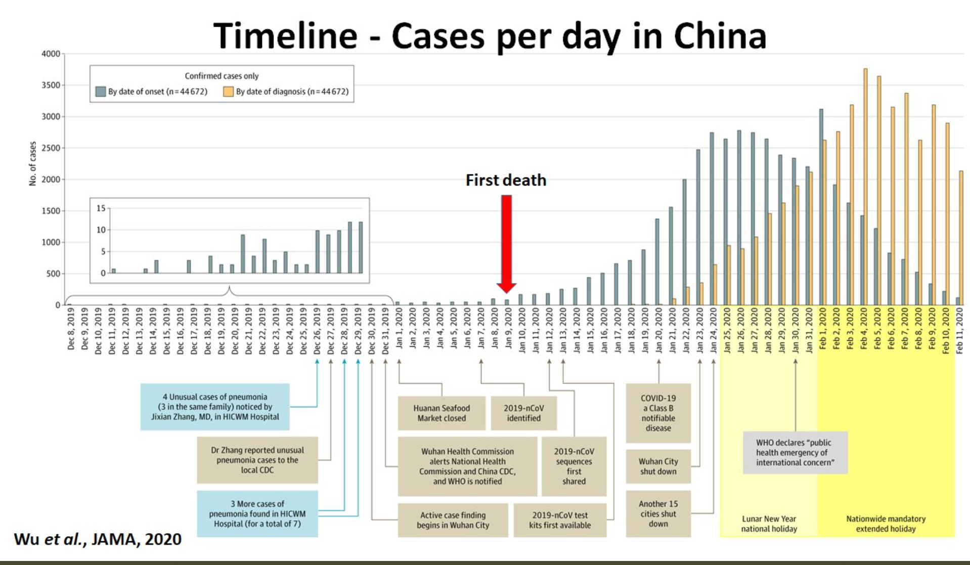
MOAR Coronavirus! II
China Beat It!
Shut down Wuhan when 200 cases per day
That seems to have been a good decision

Slide 5

MOAR Coronavirus! III
When Is It Appropriate to Move on This?
Immediate social distancing…
Self-isolate if you have a cough and a fever…
Hope that warmer temperatures will do to this what they did to SARS…
Otherwise, when do you want to start spreading out transmission. It seems that early is as good as later…

Slide 6
U.C. Berkeley: Economics 115: Spring 2020
20th Century Economic History: Lecture 12: Thirty Glorious Years, 1945–1975
Brad DeLong
Department of Economics and Blum Center, U.C. Berkeley; and WCEG
delong@econ.berkeley.edu
last revised: 2020-03-11
for delivery: W 2020-03-16 17:00 HMMB390
<https://bcourses.berkeley.edu/courses/1487684>
<https://github.com/braddelong/public-files/blob/master/econ-115-lecture-12.pptx>

Slide 7
Takeaways from Last Time
From False (and True) Starts in Emerging Markets
Come up with your own five takeaways from our look at the “False Starts”…

Slide 8
Preview
Thirty Glorious Years
Takeaways from Last Time
Preview
Administration
The Cold War: There Was Not Supposed to Be One
The Korean War
Review: Broad sweep
Consequences: After the Korean War
Russia Sits Down
Takeaways
Preview

Slide 9
Econ 115: Administration: Office Hours &c.
DeLong: Office Hours
M 11:10-12:40, Blum Hall 200B
T 11:15-12:00, Blum Hall 200B
Email <delong@econ.berkeley.edu> for a virtual appointment
Read: DeLong, chapter 16
Slides: <https://github.com/braddelong/public-files/blob/master/econ-115-lecture-16.pptx>
Do: Assignments on suspension as we figure out what to do with the midterm…
Memo: bCourses website <https://bcourses.berkeley.edu/courses/1487684>

Slide 10

Thirty Glorious Years
There was not that much ground for optimism in the immediate aftermath of World War II.
The greater, totalitarianism had been scotched—Nazi Germany. But another, if lesser, flavor—Stalin’s and Mao’s versions of really-existing socialism—were growing.
Representative and parliamentary democracy looked in no better shape after World War II than it had been in 1914.
Politicians who could rise:
told their slices of the electorate what it wanted to hear
delivered the goodies to rent-seeking interest groups
not the statesmen their countries needed
The global economy would continue to deliver political and economic dislocations:
People would continue to not be happy
Progress and growth at the cost of frequent depressions and “creative destruction”—as Karl Polanyi had argued, societies did not like that
And yet from 1938 to 1973 measured economic growth in the future G-7 jerked forward:
not at the 0.7%/year pace of 1913-1938
not at the 1.42%/year pace of 1870-1913
at an average pace of 3.0%/year.
That is a material-wealth doubling-time of 23 years:
Thirty Glorious Years: the Trentes Glorieuses.
5:30
Notes:
16.1: Refinding the Path Toward Utopia
1800-1870 saw invention and innovation in technology and organization open the door open to a better world, one in which humanity was not desperately poor under the harrow of Thomas Malthus’s fears of limited resources, near-stagnant technology, and population pressure. 1870-1913 saw humanity walk through that door.
1914-1948 or so saw the door half-close. There was the Great Depression. And there was the destruction of World Wars I and II. There were the civil and revolutionary wars—the last of which, China’s, did not come to an end until 1949. Growth in living standards over 1913-1938 was cut in half relative to 1870-1913, roughly back to or even below its 1800-1870 pace. Technology and organization were more used to kill and oppress than to free and enrich. Globalization went into reverse: countries raised barriers against imports to protect their own domestic producers. Wars sank ships. Wartime dislocations destroyed comparative advantages, and made investors and others wary of trying to construct new ones.
There was not that much ground for optimism in the immediate aftermath of World War II. Looking around at ideological challenges, at political mechanisms, and at dilemmas of growth and distribution.
One, the greater, totalitarianism had been scotched—Nazi Germany. But another, if lesser, flavor—Stalin’s and Mao’s versions of really-existing socialism—were growing. They were materially weak, and poor. But they were populous. And they had a disturbing ability to get people to endorse and fight for their cause by telling implausible lies—even about their own high cadres. Millions cheered in 1969 because the Maoists had rescued China from the traitorous American agent Liu Shaoqi: the Liu Shaoqi who had replaced Mao Zedong as President of trhe People’s Republic of China in 1959, and whom Mao had chosen as his own heir in 1961. And almost all believed it. And their rulers had some… disturbing tendencies. The don’t-rock-the-boat-peaceful-coexistence generation of leaders of the Soviet Union after Stalin were horrified to hear Mao claim that nuclear war would be good for civilization: half the world’s people would die, but those who were left would be socialists, and in two generations they would bring global population back to its then-2.7 billion—“The East Wind is prevailing over the West Wind”.
Representative and parliamentary democracy looked in no better shape after World War II than it had been in 1914. The politicians who could rise in a system of representative democracy were those who told their slices of the electorate what it wanted to hear and delivered the goodies to rent-seeking interest groups: they were not the statesmen their countries needed. So it had been in the runups to World Wars I and II, in the aftermath of World War I, and in the Great Depression.
The global economy would continue to deliver political and economic dislocations, and people would continue to not be happy. A market economy could deliver progress and growth at the cost of frequent depressions and “creative destruction” that swept away all positions, privileges, and rights that were not backed up by valuable property rights. As Karl Polanyi had argued, societies did not like that. And their reaction had delivered the catastrophes of 1914-1948. Would things be any different looking forward from the end of World War II?
And yet the world picked up its mat and walked—nay, ran—forward towards true utopia.
From 1938 to 1973 measured economic growth in the future G-7 jerked forward: not at the 0.7%/year pace of 1913-1938 or even the 1.42%/year pace of 1870-1913, but at an average pace of 3.0%/year. That is a material-wealth doubling-time of not the 100 years or so of 1913-1938 or even the 50 years of 1870-1913, but 23 years: less than a generation. The G-7 was three times as well-off in 1973 as it had been in 1938. Japan grew at a previously unseen 4.7%/year—in spite of Curtis LeMay’s firestorms and two atomic bombs that incinerated Japanese cities in 1944-1945. Canada and Italy grew at more than 3%/year. But they were not alone—Mexico and Spain as well as others achieved that rate of growth as well. The French call this period the Thirty Glorious Years: the Trentes Glorieuses.

Slide 11
Present at the Creation
Somehow, after World War II, nearly everything went right
The Great Depression had, in the United States at least, convinced the middle class that it had powerful interests in common with the working class
Hence social insurance and macroeconomic stabilization at full employment were things demanded from all political parties
The totalitarian threat from Stalin’s Soviet Union across the Iron Curtain
That created the North Atlantic alliance willing to follow America’s lead
So much good luck in one package was unexpected, and is still to marvel at!
The end of laissez-faire:
John Maynard Keynes on the cross-fertilization of laissez-faire and social darwinism:
“Interferences… [were] not merely inexpedient, but impious, as calculated to retard the onward movement of the mighty process by which we ourselves had risen, like Aphrodite, out of the primeval slime…”
1950s Republican American President Dwight Eisenhower
“It is quite clear that the Federal government cannot avoid or escape responsibilities which the mass of the people firmly believe should be undertaken…. If a rule of reason is not applied… we will lose everything…. This is what I mean by my constant insistence upon “moderation” in government. Should any political party attempt to abolish social security, unemployment insurance, and eliminate labor laws and farm programs, you would not hear of that party again in our political history. There is a tiny splinter group, of course, that believes you can do these things. Among them are H. L. Hunt (you possibly know his background), a few other Texas oil millionaires, and an occasional politician or business man from other areas. Their number is negligible and they are stupid…”
4:10
Notes:
16.1: Present at the Creation
Somehow, after World War II, nearly everything went right. Interwar and pre-World War I rich-country governments had been hobbled by their rejection of any mission to ensure general prosperity. That doctrine of laissez-faire had started out as a weapon to dismantle aristocratic mercantilism and then turned into a weapon to fight progressive taxes, social insurance programs, and “socialism” more generally. After World War II it had evaporated. The Great Depression had, in the United States at least, convinced the middle class that it had powerful interests in common with the working class—hence social insurance and macroeconomic stabilization at full employment were things demanded from all political parties that sought votes. And the totalitarian threat from Stalin’s Soviet Union across the Iron Curtain created the North Atlantic alliance willing to follow America’s lead.
So much good luck in one package was unexpected, and is still to marvel at.
16.1.1: The End of Laissez-Faire
16.1.1.1: Laissez-Faire’s Career
Laissez-faire had been the idea that the government should simply let the economy alone. The government should step back, limiting its economic role to the enforcement of contracts and protection of property rights. All beyond the duties of the “night-watchman state”—all beyond enforcement of contracts and protection of property rights—was “intervention” into the economy, and was guilty until proven innocent. Truth be told, laissez-faire was never the policy recommendation of any near-consensus of economists. Laissez-faire was, rather, what other people thought and wrote that governments had applied and economists had taught.
Nevertheless it had been a very powerful doctrine. Always in the background and often in the foreground it constantly resisted expansions of taxation, of regulation, and of the state—especially those aimed at redistributing income and wealth in a progressive direction—up until the Great Depression. Whenever there was a cruelty or a disorder in the market that might be alleviated by regulation or some other form of government regulation, there would be those who would sagely write that any such would do more harm than good—have a perverse effect. There would be an Andrew Carnegie to explain why wide inequalities in the income distribution would be for the best. There would be a Joseph Schumpeter to explain to his students that the 20%-plus unemployment of the Great Depression was a good, healthy thing.
The idea had been politically and sociologically useful to the rising and then dominant business classes from the late 1700s to the 1900s. At the start it was a weapon against the previous land-military-church aristocracy that had crafted the forms of government to enhance their own wealth and power. At the end it was an equally powerful weapon against demands from working classes for a larger share of the pie, especially when buttressed by the social darwinist claims that, again in Keynes’s words: “interferences… [were] not merely inexpedient, but impious, as calculated to retard the onward movement of the mighty process by which we ourselves had risen, like Aphrodite, out of the primeval slime…”
But by the 1950s it was Republican American President Dwight Eisenhower who wrote, in a letter to his brother Edgar, that laissez-faire was dead, and that attempts to resurrect it were simply “stupid::
It is quite clear that the Federal government cannot avoid or escape responsibilities which the mass of the people firmly believe should be undertaken…. If a rule of reason is not applied… we will lose everything…. This is what I mean by my constant insistence upon “moderation” in government. Should any political party attempt to abolish social security, unemployment insurance, and eliminate labor laws and farm programs, you would not hear of that party again in our political history. There is a tiny splinter group, of course, that believes you can do these things. Among them are H. L. Hunt (you possibly know his background), a few other Texas oil millionaires, and an occasional politician or business man from other areas. Their number is negligible and they are stupid…

Slide 12
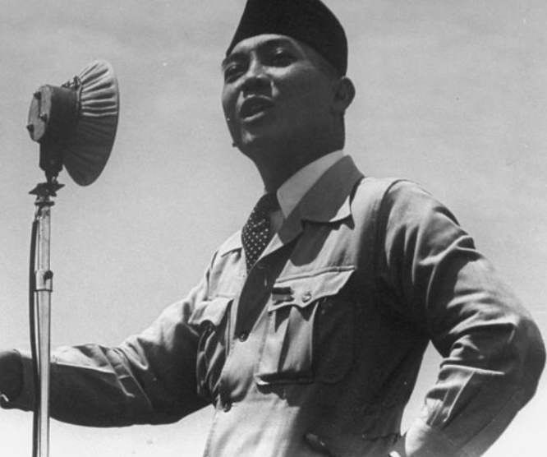
Leninist and Fascist Alternatives?
People before 1930 would probably have jumped to the conclusion that the end of laissez-faire meant the arrival of some form of Leninist socialism
People in the 1930s would probably have thought it meant some form of fascism
Vladimir Lenin during World War I:
“When a large enterprise… on the basis of exact computation of mass data, organizes according to plan the supply of primary raw materials to the extent of two-thirds or three-fourths of all that is necessary for tens of millions of people; when the raw materials are transported to the most suitable place of production, sometimes hundreds or thousands of miles away, in a systematic and organized manner; when a single center directs all the successive stages of work… then it becomes evident that we have socialization of production… that private economic relations and private property relations constitute a shell which is no longer suitable for its contents… [and] which will inevitably be removed…”
Into the 1950s, many would confidently predict that Leninist socialism and government planning would deliver a more efficient allocation of productive forces and a faster rate of economic growth than any alternative system.
Destructive of human liberty, happiness, and high mass consumption—but forging ahead in total and per capita production
But it was not to be so
What then was the alternative that was to replace laissez-faire? It was social democracy. It was the mixed economy. It was a Keynesian escape hatch
6:15
Notes:
16.1.2: Leninist and Fascist Alternatives
if you had told anyone before 1930 that by the end of the 1930s laissez-faire would have been dead as a doctrine for guiding economic policy, they would probably have jumped to the conclusion that the end of laissez-faire meant the arrival of some form of Leninist socialism: the end of the market economy, and its replacement by a socialized, militarized economy in which the government owned everything of value and directed who should go where and work on what. There was fear of—and hope for—the alternative to laissez-faire would be some organized collectivist Leninist dystopia or utopia.
Had not the years leading up to 1929 seen the increased monopolization and concentration of the economy? Were not the largest firms in 1929 bigger than whole economies had been half a century earlier? Did not major investment banking firms like J.P. Morgan and Company (in the U.S.), the Deutsche Bank (in Germany), or the Yasuda zaibatsu (in Japan) exercise a remarkable amount of command and control over the economy’s large-scale investment decisions? As Vladimir Lenin had written during World War I:
When a large enterprise… on the basis of exact computation of mass data, organizes according to plan the supply of primary raw materials to the extent of two-thirds or three-fourths of all that is necessary for tens of millions of people; when the raw materials are transported to the most suitable place of production, sometimes hundreds or thousands of miles away, in a systematic and organized manner; when a single center directs all the successive stages of work… then it becomes evident that we have socialization of production… that private economic relations and private property relations constitute a shell which is no longer suitable for its contents… [and] which will inevitably be removed…
Lenin—and many others—had seen socialism already fully built in the large organizations of vertically-integrated manufacturing firms and in the loose financial empires of bankers: the new economy in the womb of the old. Laissez-faire advocates had promised that the market economy could deliver. And in the 1930s it had not. It was time for socialism. And by 1945 there was a socialism up and running in the USSR. Lenin and Stalin’s brand of socialism had turned a country of peasants, animal-powered small farms, and craftsmen into a country of industrial workers, machine-powered collective firms, and factories. They had—they claimed—done in one generation the economic transformation that had taken five generations in Britain. And it was theiur, not the Johnny-come-latelies who has only dared put troops into northwest Europe in the final year before the Nazi collapse, citizens who had spent the blood that had won World War II against the Nazis.
Into the 1950s, many outside the USSR—take left-wing economist Paul Sweezy, fired from Stanford for being a communist during the McCarthy era even as the establishment pontificated about the importance of maintaining academic freedom for one—would confidently predict that Leninist socialism and government planning would deliver a more efficient allocation of productive forces and a faster rate of economic growth than any alternative system.Many who feared Leninist socialism as destructive of human liberty, happiness, and high mass consumption agreed that the USSR and its satellites were likely to forge ahead in total and per capita production. Really existing state socialism had inefficiencies, but market economies—as the Great Depression had proved—had gross inefficiencies too. And even if centrally-planned economies of scale did not outweigh inefficiencies from abandoning market coordination, a centrally-planned economy would have no difficulty in attaining a high rate of investment. Paul Samuelson—no Leninist he—had the leading post-World War II American economics textbook. Up until the late 1960s its forecasts showed the USSR surpassing the American economy in production per head well before 2000.
Perhaps in the 1930s some form of fascism might have been seen as an alternative mode than some Leninist really-existing socialism. Preserve some traditional orders and hierarchies, prioritize the ethno-nation and its resentments of outsiders who did not fully belong to the national community over the class as the organizing principle, prioritize full employment rather than financial orthodoxy, and have a strong leader knock heads and purge bodies to keep those who wanted to nationalize property under the bureaucratic control of the government out of power—perhaps that was the wave of the future that could resist really-existing socialism. Certainly many in Europe who feared Lenin and Stalin thought so. Right-wing economist Ludwig von Mises wrote: “Fascism and similar movements aiming at the establishment of dictatorships are full of the best intentions and that their intervention has, for the moment, saved European civilization. The merit that Fascism has thereby won for itself will live on eternally in history…” Right-wing anti-socialist, anti-liberal, and anti-Nazi political philosopher Leo Strauss called for fighting against Hitler on the basis of the “principles of the right, that is from fascist, authoritarian and imperial principles…”—although, for Strauss, the “fascist principles” he was thinking of those may well have been those of the Roman Republic rather than those of Mussolini. But fascism was defeated in World War II.
What then was the alternative that was to replace laissez-faire? It was social democracy. It was the mixed economy. It was a Keynesian escape hatch that combined market economies with a dose of light central planning, public funding of programs to advance societal well-being, and progressive taxation

Slide 13
The Coming of Social Democracy
Social democracy was possible only because laissez-faire was discredited
And what discredited laissez-faire where the rubber meets the road was Keynesianism
Simple, technical interventions to correct laissez- faire visibly worked to provide full employment
Thus the burden of proof shifted to those who claimed that laissez-faire could not or should not be corrected in others as well
So what succeeded laissez faire was not socialism but something called the “mixed economy”: social democracy
Some countries attempted to exit depression through the Keynesian escape hatch n the 1930s. They had indeed done relatively well
World War II provided further proof: The United States fought World War II without reducing the real value of civilian consumption
All U.S. war production came from new capacity, or from capacity that stood idle at the end of the 1930s
In retrospect, the semi-accidentally Keynesian policies of moderate expansion, inﬂation, and devaluation in the interwar period might have owed some of their success to the fact that they were the exception rather than the rule
One way to read Keynes’s General Theory is as a confident bet that all that was needed in order to remove the major deficiencies of laissez-faire were relatively minor reforms,
Keynes won the bet he had placed in his General Theory, claiming that his plans for
“adjusting to one another the propensity to consume and the inducement to invest… as the only practicable means of avoiding the destruction of existing economic forms in their entirety and as the condition of the successful functioning of individual initiative”
and pointing out that as long as full employment could be maintained: “there will still remain a wide field for the exercise of private initiative and responsibility” where “the traditional advantages of individualism will still hold good”.
Critics of the Keynesian order engaged in a Ptolemaic “saving the phenomena”.
Milton Friedman promoted monetary policy and eschewed fiscal policy
That carrying out a “neutral” monetary policy was simple
He was wrong: correctly carrying out a “neutral” monetary policy was not at all simple
In fact, the only working definition of a “neutral” monetary policy is one that provides stable full employment
8:15
Notes:
But what succeeded laissez faire was not socialism but something called the “mixed economy.” That had by the end of World War II become the dominant ideology in the world economy’s North Atlantic industrial core. That provided North America and western Europe with a Keynesian escape hatch from what had been insoluble crises and contradictions in the interwar period.
Some countries attempted to exit depression through the Keynesian escape hatch in the 1930s. They had indeed done relatively well. The Great Depression was relatively mild in countries that had devalued their currencies early, printed money and inflated their price levels, ensured low interest rates, and had run large budget deficits. World War II provided further proof: In the United States unemployment had been called “structural” or “permanent” during the 1930s, and had appeared immune to the self-adjusting forces of the market as well as to the entire armament of the New Deal. That unemployment vanished entirely in the 1940s under the pressure of vastly expanded government spending. The United States fought World War II without reducing the real value of civilian consumption: all U.S. war production came from new capacity, or from capacity that stood idle at the end of the 1930s. In retrospect, the accidentally Keynesian policies of moderate expansion, inﬂation, and devaluation in the interwar period might have owed some of their success to the fact that they were the exception rather than the rule. To the extent that the background assumptions of gold standard discipline and deflation remained in force, accidentally “Keynesian” might have been more effective when implemented against this background. But there was a catch-22: any strong attachment to gold-standard principles would ensure that Keynesian policies would not be systematically undertaken—for central bankers and politicians shared the same background assumption about how the world should work.
One way to read Keynes’s General Theory is as a confident prediction that all that was needed in order to remove the major deficiencies of laissez-faire were relatively minor reforms, and that such relatively minor reforms could successfully stabilize the economy with nearly-perpetual full employment. An activist welfare-state government with a commitment to full employment had the tools to level the distribution of income, eliminate Great Depressions, and could put economies back onto the road to utopia. If governments would only lower interest rates and spend money freely (without raising taxes) in times when total demand was low and raise interest rates and raise taxes (without spending) in times when total demand was high, Great Depressions could be avoided.
Thus Keynes won the bet he had placed in his General Theory, claiming that his plans for “adjusting to one another the propensity to consume and the inducement to invest… as the only practicable means of avoiding the destruction of existing economic forms in their entirety and as the condition of the successful functioning of individual initiative”, and pointing out that as long as full employment could be maintained: “there will still remain a wide field for the exercise of private initiative and responsibility” where “the traditional advantages of individualism will still hold good”.
And, indeed, when you look closely at what the critics of the Keynesian order were saying, many of them were engaged in simply “saving the phenomena”. For example, Milton Friedman promoted monetary policy and eschewed fiscal policy as a stabilization tool. He believed that correctly carrying out a stabilizing monetary policy was simple, that fiscal policy was less effective than monetary policy, and that the that deficit spending associated with the use of fiscal policy to ensure full employment carried long-run dangers of its own in the form of ultimate fiscal insolvency. It turned out he was wrong: correctly carrying out a stabilizing monetary policy was not at all simple. But at the bottom the message was the same: a government that intervened on as large a scale to guide spending could guard the economy against Great Depressions without succumbing to the trap of socialist ideals leading to an over-mighty government that would in the end destroy political liberty and economic prosperity. It was just that Milton Friedman claimed that such intervention was not intervention at all, but only following a “neutral” monetary policy.
In the first post-World War II generation the Keynesian escape hatch provided governments, polities, and economies with what seemed like a miraculous solution to all the interwar dilemmas. It was no accident that U.S. Secretary of State Dean Acheson titled his memoirs Present at the Creation, for he and his peers truly had been present at the creation of an extraordinarily fruitful framework of political and economic institutions
So how did it happen that the first post-World War II generation of governments found their way to adopting the policies that led through the Keynesian escape hatch? And why was Keynes so right—why were his policy recommendations so apt for the post-World War II world?

Slide 14
Solidifying Social Democracy
The shadow of the past
The political and economic struggle between parties and classes in interwar Europe had ended in the mutual ruin of the contending parties
The magnitude of Depression-era unemployment also shifted politicians’, industrialists’, and bankers’ beliefs about the key goals of economic policy
Entrepreneurs, the owners and managers of real capital—industry—and even the bankers found that they gained, not lost, from a commitment to maintain high employment first
There is a sense in which Christian and social democracy evaded class-conﬂict based dilemmas because the shock of the Great Depression shifted politics from a concern over redistribution to a concern over production
Maier: “The true dialectic was not one of class against class, but waste versus abundance…”
It is very hard to argue that accepting the “mixed economy” was a mistake for anyone
Had either owners or workers tried to hold out for more—as they did in the interwar period—they might well have ended up with far less.
How far down must one go in the income distribution to ﬁnd citizens of the United States or West Germany who were worse off in 1990, in a material sense, than the average citizen of Czechoslovakia was then, when the Iron Curtain fell?
4:00
Notes:
A first, very important factor helping to make post-World War II economic reconstruction a success was the shadow of the past. Post-World War II reconstruction took place against the background catastrophe of World War II and of the preceding Great Depression.
The political and economic struggle between parties and classes in interwar Europe had ended in the mutual ruin of the contending parties. Right-wing factions had wanted low wages, no welfare state, stable prices (along with social order and nationalist self-assertion); left-wing factions had wanted high wages and an extensive welfare state. The far left had no tolerance for the near left. Mainline politicians in the interwar period, whether social democrats looking forward to the implementation of the socialist Gotha Program or Clause IV, or right-wing politicians interested in demolishing the embryonic welfare state and restoring traditional authorities, had looked forward to establishing their vision of the distribution of wealth and the role of the government by overrunning opposition—at the ballot box if possible, and through street violence and purges if necessary. The end of this political and economic struggle had been the rise of fascism and Nazism, which had benefitted no one.
The magnitude of Depression-era unemployment also shifted politicians’, industrialists’, and bankers’ beliefs about the key goals of economic policy. Before the Depression a stable currency and exchange rate were key. But after the Depression even the bankers recognized that a high overall level of employment was more important than avoiding inflation: universal bankruptcy and mass unemployment were bad for workers, but they were worse for capitalists and bankers.
Thus entrepreneurs, the owners and managers of real capital—industry—and even the bankers found that they gained, not lost, from a commitment to maintain high employment first. High employment meant high capacity utilization. Rather than seeing tight labor markets erode proﬁt margins by raising wages, owners of property saw high demand spread ﬁxed costs out over more commodities and so increase proﬁtability.
There is a sense in which Christian and social democracy, the twin political powers of the post-World War II world, evaded class-conﬂict based dilemmas of the interwar and pre-World War I politics because the shock of the Great Depression shifted politics from a concern over redistribution to a concern over production. All would lose heavily from another Great Depression. It seemed much more worthwhile to compromise, and to pursue policies that would enlarge the pie to be distributed rather than for either side—either the left or the right—to engage in substantial redistribution. For all parties the post-World War II mission became, in Charles Maier’s words:
one of expanding aggregate economic performance and eliminating poverty by enriching everyone, not one of redressing the balance among economic classes or political parties. The true dialectic was not one of class against class, but waste versus abundance.
It is very hard to argue that accepting the “mixed economy” was a mistake for anyone. Had either owners or workers tried to hold out for more—as they did in the interwar period—they might well have ended up with far less. How far down must one go in the income distribution to ﬁnd citizens of the United States or West Germany who were worse off in 1990, in a material sense, than the average citizen of Czechoslovakia was then, when the Iron Curtain fell?

Slide 15
In a Latin American Mirror…
Meanwhile, on another nearby branch of the universe’s quantum wave function
Overlapping ours in space and time yet as invisible to us in the sense that a radio tuned to 99.7 hears that only and is oblivious to 104.5
It sees the maintenance and expansion of wartime controls in order to guard against substantial shifts in income distribution. Allocative bureaucracies to ration scarce foreign exchange. Pice controls on exportables in order to protect the living standards of urban working classes
This happened in much of Latin America
Which missed out on the boom of the two decades after World War II.
Consider Argentina.
Before the war, Argentina had been as rich as Continental Europe: Buenos Aires was among the top 20 cities of the world in telephones per capita, Argentina had been perhaps fourth in density of motor vehicles per capita
In Carlos Díaz-Alejandro’s estimation, four factors set the stage for Argentina’s relative decline:
a politically-active and militant urban industrial working class,
economic nationalism,
sharp divisions between traditional elites and poorer strata, and
a government used to exercising control over goods allocation that viewed the price system as a tool for redistributing wealth rather than for regulating the pattern of economic activity.
From the perspective of 1947, the political economy of Western Europe would lead one to think that it was at least as vulnerable as Argentina.
Yet Europe avoided these traps:
Government ownership of utilities and heavy industry was substantial
Government redistributions of income were large
The magnitude of the “safety nets” and social insurance programs provided by the post-World War II welfare states were far beyond anything that had been thought possible before World War I
But these large welfare states were accompanied by financial stability, and by substantial reliance on market processes for allocation and exchange
7:00
Notes:
16.2.3.2: Post-World War II Western Europe in a Latin American Mirror
There is an alternative scenario—an alternate universe—another branch on the universe’s quantum wave function, overlapping ours in space and time yet as invisible to us in the sense that a radio tuned to 99.7 hears that only and is oblivious to 104.5—that saw the maintenance and expansion of wartime controls in order to guard against substantial shifts in income distribution. The late 1940s and early 1950s might have seen the creation in Western Europe of allocative bureaucracies to ration scarce foreign exchange. It might have seen the imposition of price controls on exportables in order to protect the living standards of urban working classes—as happened in various countries Latin America, which nearly stagnated in the two decades after World War II.
Consider Argentina. Before the war, Argentina had been as rich as Continental Europe. In 1913 Buenos Aires was among the top 20 cities of the world in telephones per capita. In 1929 Argentina had been perhaps fourth in density of motor vehicles per capita, with approximately the same number of vehicles per person as France or Germany. Argentina from 1870-1945 was a country in the same class as Canada or Australia. Yet after World War II, Argentina grew very much more slowly than France or Germany, rapidly falling from the ranks of the First World to the Third. Features of the international environment benefitting post-WWII Europe—the rapid growth of world trade under the Bretton Woods system, for example—offered the same potential benefits to post-World War II Argentina.
Might western Europe have followed a similar post-WWII trajectory? In Carlos Díaz-Alejandro’s estimation, four factors set the stage for Argentina’s relative decline: a politically-active and militant urban industrial working class, economic nationalism, sharp divisions between traditional elites and poorer strata, and a government used to exercising control over goods allocation that viewed the price system as a tool for redistributing wealth rather than for regulating the pattern of economic activity. From the perspective of 1947, the political economy of Western Europe would lead one to think that it was at least as vulnerable as Argentina.
Yet Europe avoided these traps. By 1949 national income per capita in Britain, France, and Germany had recovered to within a hair of pre-war levels. By 1951, six years after the war and at the effective end of the Marshall Plan, national incomes per capita were more than 10 percent above pre-war levels. Measured by the yardstick of the admittedly imperfect national product estimates, the three major economies of Western Europe had achieved a degree of recovery that post-World War I Europe had not reached in the 11 years separating World War I from the Great Depression.
No central bank or government pursued monetary orthodoxy so aggressively to roll back price and wage increases and preserve the real wealth of rentiers. Struggles over the distribution of income and wealth in “wars of attrition” were less virulent, in large part because memories of the disastrous consequences of the aggressive pursuit of redistributional goals during the interwar period made moderation appear more attractive to all. French, Italian, Low Countries, and West German growth during the post-World War II boom raised national product per capita at rates that far exceeded pre-World War II, pre-1929, or even pre-1913 trends. “Supergrowth,” Charles Kindleberger has termed it.
Western Europe’s mixed economies built substantial redistributional systems. But they built these systems on top of and not as replacements for market allocations of goods and factors. Though there was support for the restoration of a market economy in Western Europe, it was far from universal. Wartime controls were viewed as exceptional policies for exceptional times, but it was not clear what was to replace them. Communist and some Socialist ministers opposed a return to the market. It was not clear when, or even if, the transition would take place. Yet it did.
Post-World War II Europe was very far indeed from laissez faire. Government ownership of utilities and heavy industry was substantial. Government redistributions of income were large. The magnitude of the “safety nets” and social insurance programs provided by the post-World War II welfare states were far beyond anything that had been thought possible before World War I. But these large welfare states were accompanied by financial stability, and by substantial reliance on market processes for allocation and exchange.

Slide 16
Review: Broad Sweep
What was the growth rate of ideas in the industrial core of the world economy over 1870-2020?
About 2.3%/year
About 0.9%/year
About 0.23%/year
About 4%/year
None of the above

Slide 17
Review: Broad Sweep
What was the growth rate of ideas in the industrial core of the world economy over 1770-1870?
About 2.1%/year
About 0.45%/year
About 0.15%/year
About 0.04%/year
None of the above

Slide 18
Marshall Plan and After
Why did things go so right?
In the U.S., luck: the New Deal
In Europe, luck: the U.S. was there, and dominant
Fight communism!
Columnist Richard Strout: “one way of combating Communism is to give western Europe a full dinner pail.”
The Marshall Plan
A large multi-year commitment.
From 1948 to 1951, the U.S. contributed $13.2 billion to European recovery. $3.2 billion went to the United Kingdom, $2.7 billion to France, $1.5 billion to Italy, and $1.4 billion to the Western-occupied zones of Germany that would become the post-World War II Bundesrepublik.
Figure 1% of United States national income as a flow.
Figure 3% of western European national income.
Marshall Plan dollars did affect the level of investment
But these direct effects are small potatoes
Perhaps it was the political-economic effects that were dominant.
Marshall Plan aid was preconditioned on successful financial stabilization
Balanced budgets required successful resolution of distributional conflicts
The Marshall Plan gave European countries a pool of resources that could be used to cushion the losses sustained in restructuring
Marshall Plan administrators pressured European governments and interest groups to compromise, and Marshall Plan transfers could reduce the sacrifices required of competing distributional interests
7:00

Slide 19
“Supergrowth”
By 1949 average GNP per capita in the three large countries had recovered to within a hair of its pre-war level
Recovery was two years ahead of its post-World War I pace
What post-World War II Europe accomplished in six years had taken post-World War I Europe sixteen
The restoration of financial stability and the free play of market forces launched the European economy onto a more-than-two-decade-long path of unprecedented rapid growth: 2 percent per annum between 1870 and 1913, 2.5 percent per annum between 1922 and 1937, an astonishing 4.8 percent per year between 1953 and 1973, before slowing to half that rate from 1973 to 1979.
Consider the west German economy
Recovery in the 1940s can be understood as recovering the productive capacity that had existed before the war, with the added benefit of an extra decade and a half’s worth of technology
But the German economy in the 1950s crashed through the output-per-capita levels that would have been projected by someone connecting pre-World War I peaks
The reduction of unemployment from double-digit levels to zero-digit levels took place with no sign of inflation or excess demand pressure at all: the average inflation rate from 1949 to 1970 was 1.7 percent per year
3:00
Notes:
Boom in the 1950s and 1960s the western European economies certainly did.
Even the most casual glance at numbers and growth rates reveals that growth and recovery after World War II was astonishingly rapid. Considering the three largest Western European economies—Britain, France, and Germany—the Second World War inﬂicted much more damage and destruction on a much wider area than the First. And (except for France) manpower losses were greater in World War II as well. The war ended with 24 percent of Germans born in 1924 dead or missing, and 31 percent disabled; post-war Germany contained 26 percent more women than men.
Yet the pace of post-World War II recovery soon surpassed that seen after World War I. By 1949 average GNP per capita in the three large countries had recovered to within a hair of its pre-war level, and in comparative terms recovery was two years ahead of its post-World War I pace. By 1951, six years after the war, GNP per capita was more than ten percent above its pre-war level, a degree of recovery that post-World War I Europe did not reach in the eleven post-World War I years before the Great Depression began. What post-World War II Europe accomplished in six years had taken post-World War I Europe sixteen. The restoration of financial stability and the free play of market forces launched the European economy onto a more-than-two-decade-long path of unprecedented rapid growth. European economic growth between 1953 and 1973 was twice as fast as for any comparable period before or since. The growth rate of GDP was 2 percent per annum between 1870 and 1913 and 2.5 percent per annum between 1922 and 1937. In contrast, growth accelerated to an astonishing 4.8 percent per year between 1953 and 1973, before slowing to half that rate from 1973 to 1979. Moreover, the post-World War II recovery did more than just rapidly restore Western Europe to its previous peacetime long-run growth path. French and German growth during the long-post World War II boom carried total production per capita to levels that far outstripped their economies’ pre-1929 or even pre-1913 growth trends. In both France and West Germany labor productivity had outstripped their pre-1913 trends by 1955, and thereafter saw no noticeable slackening of growth. The dynamic of western European growth after World War II is an order of magnitude stronger than had hitherto been seen.
16.3.1.1: The Transformation of West Germany
Consider, as an example, the west German economy. Recovery in the 1940s can be understood as recovering the productive capacity that had existed before the war, with the added benefit of an extra decade and a half’s worth of technology. But the German economy in the 1950s crashed through the output-per-capita levels that would have been projected by someone connecting pre-World War II peaks, and has come to rest since 1973 at about its pre-1913 growth rate, at a level of output-per-capita some forty percent higher than projected from pre-World War II experience. The magnitude of the boom came as a surprise to the Germans. The real value of a basket of German stocks multiplied eightfold during the 1950s. Unemployment in 1950 was ten percent. By 1960 it was down to one percent of the labor force. This reduction of unemployment from double-digit levels to zero-digit levels took place with no sign of inflation or excess demand pressure at all: the average inflation rate from 1949 to 1970 was 1.7 percent per year. And this reduction of unemployment did not trigger anything like the degree of labor strife that had characterized pre-World War II (and pre-World War I) Germany.

Slide 20
Bretton Woods
International monetary disorder—financial crises, devaluations, hyperinflations, trade restrictions for balance-of-payments reasons—had been a principal obstacle to recovery after World War I
Bretton Woods
The American delegation headed by Treasury Assistant Secretary Harry Dexter White
The British delegation headed by John Maynard Keynes
Keynes looked forward to a world in which countries could change their exchange rate parities relatively freely, and foresaw the application of trade and exchange restrictions in order to keep the requirements of the balance of payments from interfering with the pursuit of full employment.
White, by contrast looked forward to a world of free capital flows and fixed and rarely-adjusted exchange rates
In White’s conception, countries would be allowed to change their exchange rates only if the IMF permitted it.
The Bretton Woods system that they wound up constructing departed from the gold standard substantiallys:
Exchange rates were fixed and pegged, but the pegs were adjustable in response to “fundamental disequilibrium.”
Countries were allowed to adjust their currencies by up to ten percent—after consulting with the IMF—in cases of “fundamental disequilibrium”
Controls on international capital flows were explicitly allowed: Keynes and White had no desire to see international speculators move exchange rates and upset governments’ policies.
The International Monetary Fund was established to be a referee
The Bretton Woods pegged the dollar to gold at $35 a (troy) ounce, and pegged other currencies to the dollar.
The system held—barely
But barely was good enough for the Thirty Glorious Years
5:00
Notes:
International monetary disorder—financial crises, devaluations, hyperinflations, trade restrictions for balance-of-payments reasons—had been a principal obstacle to recovery after World War I. The international monetary system has relatively little role in the history-of-events of the generation after World War II because not much went wrong: another example of the principle that “happy is the land that has no history.” When the delegations—the American delegation headed by Treasury Assistant Secretary Harry Dexter White, the British delegation headed by John Maynard Keynes, and the other delegations—met in the somewhat faded and substantially under-plumbinged mountain resort of Bretton Woods, New Hampshire, to build a post-WWII international monetary system, their minds were focused on what they saw as the lessons of the interwar period.
Keynes and White drew somewhat different lessons from the interwar period.
Keynes looked forward to a world in which countries could change their exchange rate parities relatively freely, and foresaw the application of trade and exchange restrictions in order to keep the requirements of the balance of payments from interfering with the pursuit of full employment. He looked to an International Monetary Fund that would provide extensive balance-of-payments financing (“subject to increasingly demanding conditionality and penalty interest rates” imposed on both trade-surplus and trade-deficit countries).
White, by contrast looked forward to a world of free capital flows and fixed and rarely-adjusted exchange rates. In White’s conception, countries would be allowed to change their exchange rates only if the IMF permitted it.
The Bretton Woods system that they wound up constructing departed from the gold standard in three interlinked ways:
1. Exchange rates were fixed and pegged, but the pegs were adjustable in response to “fundamental disequilibrium.” The idea was to avoid a situation like that of Britain in the late 1920s, when either devaluation or deflation is called for, and adherence to the rules of the game of the gold standard would force deflation and a prolonged depression.
2. Countries were allowed to adjust their currencies by up to ten percent—after consulting with the IMF—in cases of “fundamental disequilibrium,” although larger changes were supposed to wait upon formal IMF approval.
3. Controls on international capital flows were explicitly allowed: Keynes and White had no desire to see international speculators move exchange rates and upset governments’ policies.
16.3.2.2: The International Monetary Fund
The International Monetary Fund was established to be a referee. Countries were supposed to maintain ﬁxed exchange rate parities vis-a-vis one another. But when one country ran a persistent balance of payments deﬁcit that threatened to exhaust its reserves, it could borrow from the IMF. The IMF would extend financial support to countries that needed more reserves to ride out a temporary balance-of-payments deficit. But the IMF would also be the judge of whether “fundamental disequilibrium” existed—and thus of whether exchange rate pegs should be changed, and whether policies or the level of the exchange rate needed to be changed to restore balance.
The Bretton Woods pegged the dollar to gold at $35 a (troy) ounce, and pegged other currencies to the dollar. As long as American policy makers’ commitment to the Bretton Woods parity remained firm, limits were placed on the extent of inflationary policies. As long as European policy makers were loath to devalue against the dollar, limits were placed on their policies as well. Price expectations were stabilized. Inflation, where it surfaced, was more likely to be regarded as transitory. Consequently, increased pressure of demand was less likely to translate into higher prices than into higher output, and higher employment—as long as the system held.
The system held—barely. The Bretton Woods system did not work as designed. Even from the beginning the idea of an adjustable peg proved to be, as Eichengreen puts it, an “oxymoron.” Moreover, the IMF’s ability to oversee what was going on and to pressure countries to adopt system-stabilizing policies soon proved very limited. And the IMF’s resources were always much too small.

Slide 21
Technological Diffusion and Multinational Enterprise
The first post-World War II generation turned into the second
Industries in the industrial core became more and more characterized by “mass production”
If Ford could redesign production so that unskilled assembly line workers do what skilled craftsmen used to do, why couldn’t Ford also-or someone else-redesign production so that it could be carried out by low wage Peruvians or Poles or Kenyans?
Industries did migrate, but they did so surprisingly slowly.
Political risk of all kinds
Substantial advantages for a ﬁrm in keeping production in the industrial core
A reliable electric power grid was much more likely to be found in the industrial core.
And so were the services of specialists needed to ﬁx the many things that can go
These factors were an order of magnitude more important for industries that are in technological ﬂux than for those that have a settled, relatively unchanging technology
As industries reached technological maturity, freeze their production processes into set patterns, and became businesses in which sales are made on the basis of the lowest price, they did tend to migrate
In the words of a Japanese development advisor, older siblings hand down to younger ones clothes they no longer need.
All this was to change later on, as the world economy entered the post-1990 age of value chains.
4:00
Notes:
As the first post-World War II generation turned into the second, and as industries in the industrial core became more and more mechanized—more and more characterized by “mass production”—they should have become more and more vulnerable to foreign competition from other, lower wage countries. If Ford could redesign production so that unskilled assembly line workers do what skilled craftsmen used to do, why couldn’t Ford also-or someone else-redesign production so that it could be carried out by low wage Peruvians or Poles or Kenyans rather than by Americans, who are extraordinarily expensive labor by world standards? Industries did migrate from the rich industrial core to the poor periphery. But in the first post-WWII generation or two they did so surprisingly slowly. One reason was added risk: political risk of all kinds tends to make investors wary of committing their money in places where it is easy to imagine political disruptions from the left or the right. Moreover, there were substantial advantages for a ﬁrm in keeping production in the industrial core, near to other machines and near other factories making similar products. It was much easier to keep the machines running. A reliable electric power grid was much more likely to be found in the industrial core. And so were the services of specialists needed to ﬁx the many things that can go wrong-minimum efﬁcient scale for an industrial civilization can be far larger than the apparent minimum efﬁcient scale for a plant. These factors were an order of magnitude more important for industries that are in technological ﬂux than for those that have a settled, relatively unchanging technology. A principal advantage of locating near the ﬁrms that make your machines came from the interchange and feedback of users and producers-feedback that is valuable only if designs are still evolving. And the principal advantage of a machine-knowing and relatively well-educated labor force was the ability to adapt to using slightly different machines in somewhat different ways—once again, valuable only if small changes are constantly being made.
As industries reached technological maturity, freeze their production processes into set patterns, and become businesses in which sales are made on the basis of the lowest price, they did tend to migrate to the periphery of the world economy: handed down to poorer countries as, in the words of a Japanese development advisor, older siblings hand down to younger ones clothes they no longer need.
And all this was to change later on, as the world economy entered the post-1990 age of value chains.

Slide 22
Takeaways from This Time
Thirty Glorious Years
Give me five takeaways from this lecture…

Slide 23
Notes: What Was Unconvincing Today?
Mistakes and unclarities: typos, wordos, and mindos…
In the DRAFT textbook?
In the lecture?

Slide 24
Catch Our Breath…
Ask a couple of questions?
Make a couple of comments?
Any more readings to recommend?

Slide 25
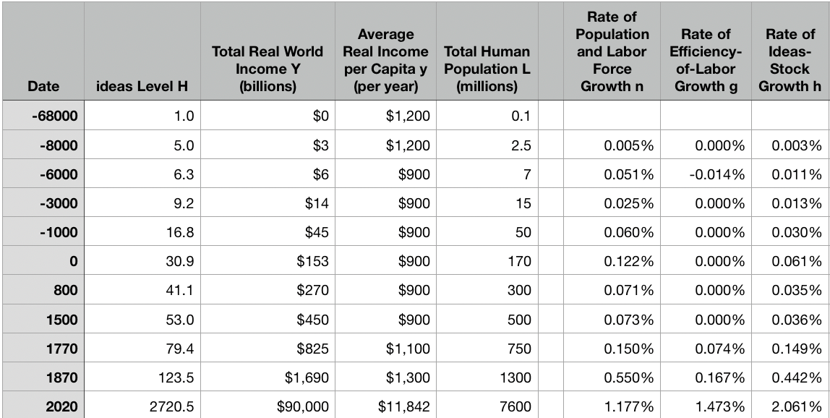
Reviews
Post-1870 is the miracle:

Slide 26
Review: The Broad Sweep
Post-1870 is the miracle:

Slide 27
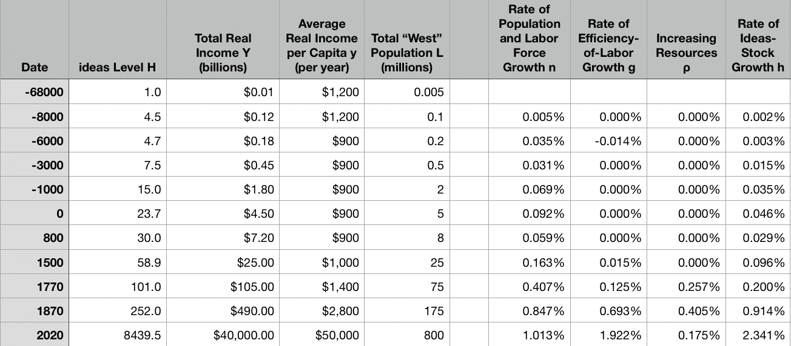
“The West”
800, 1500, 1770, or 1870?:

Slide 28
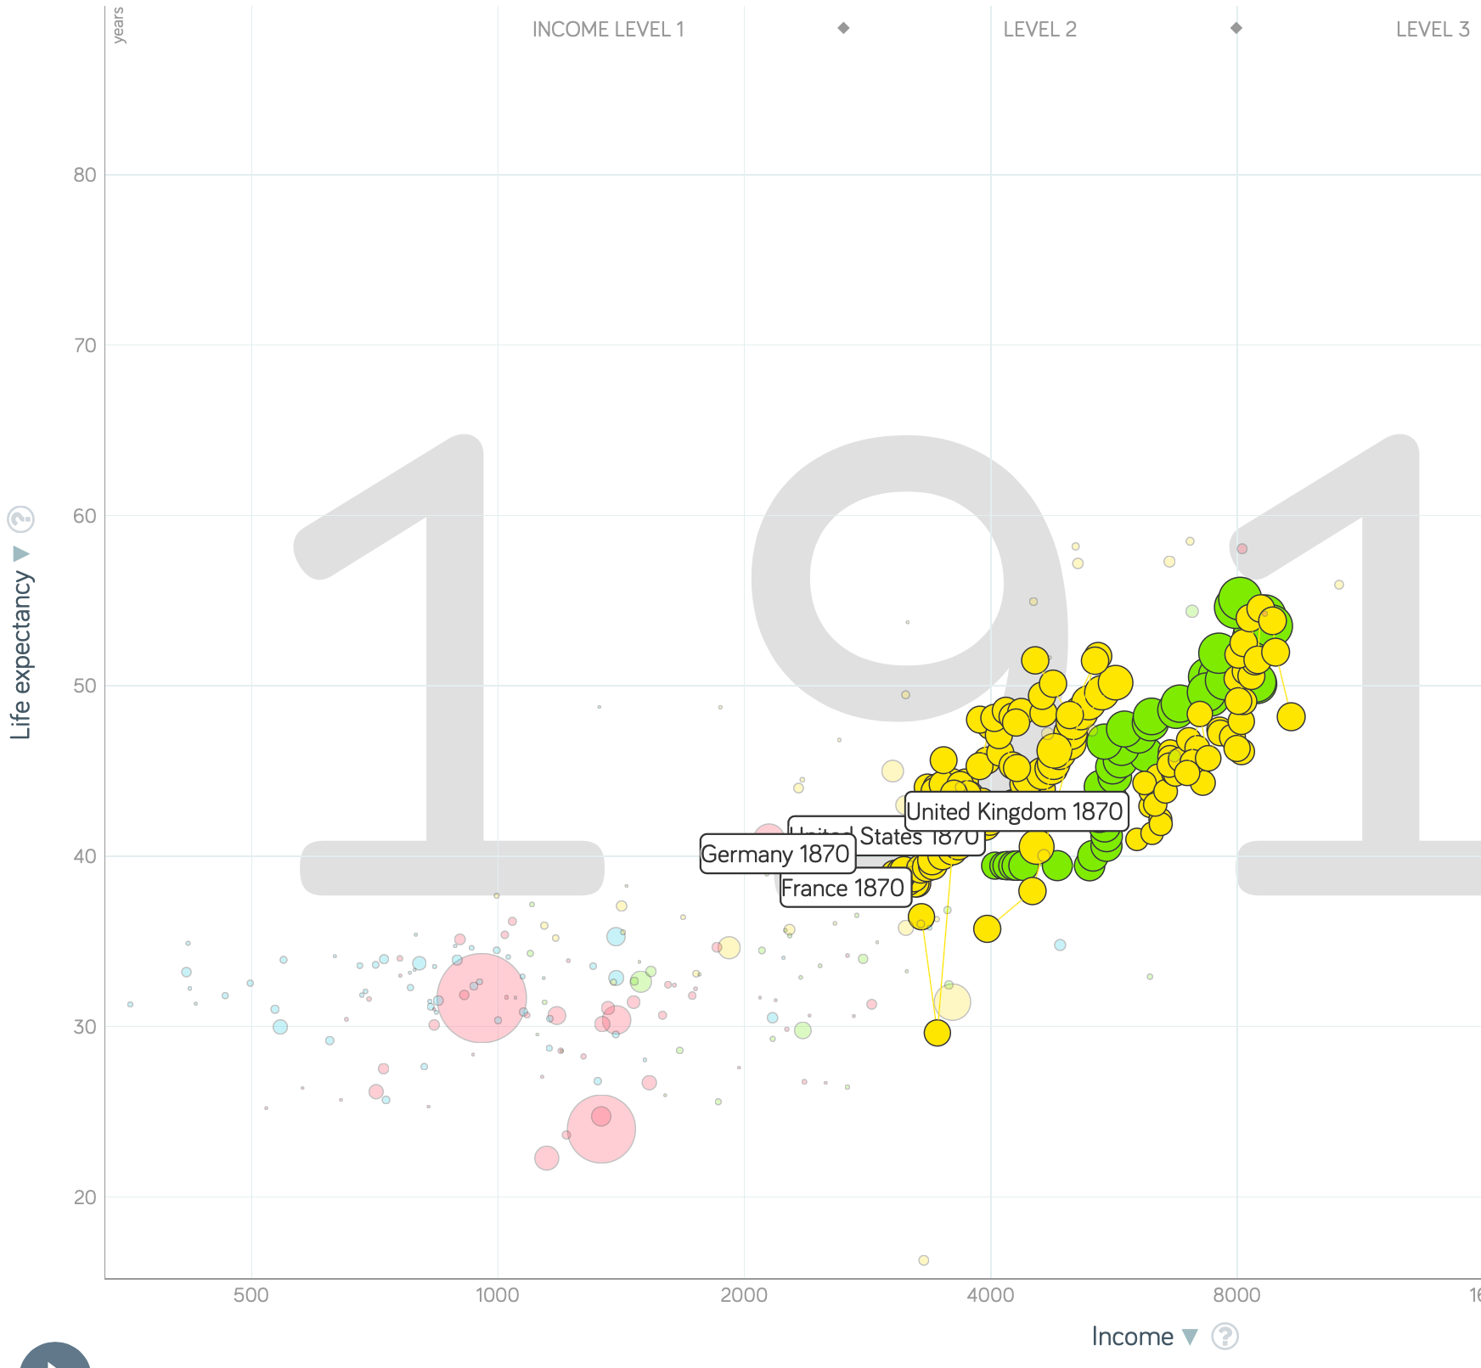
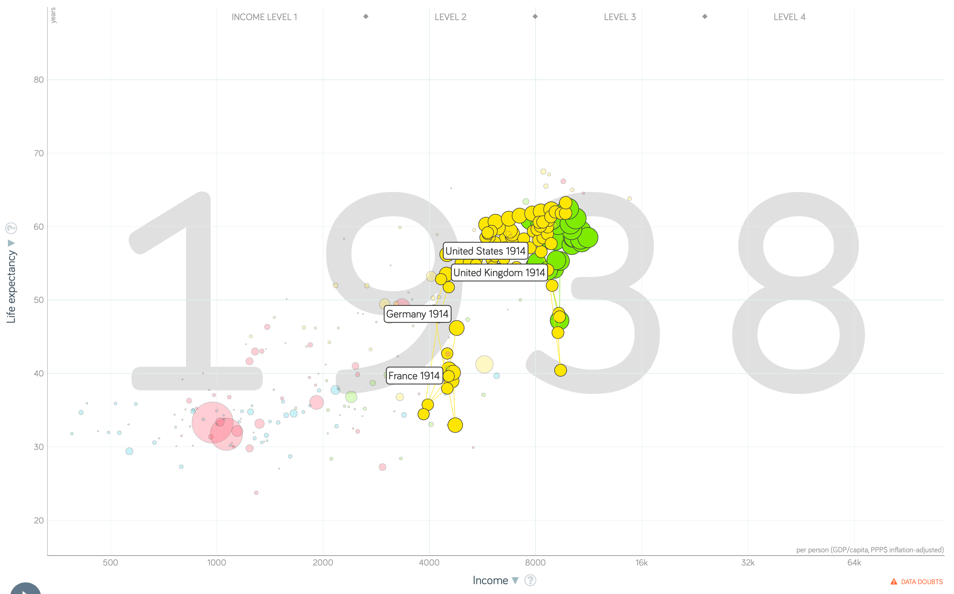
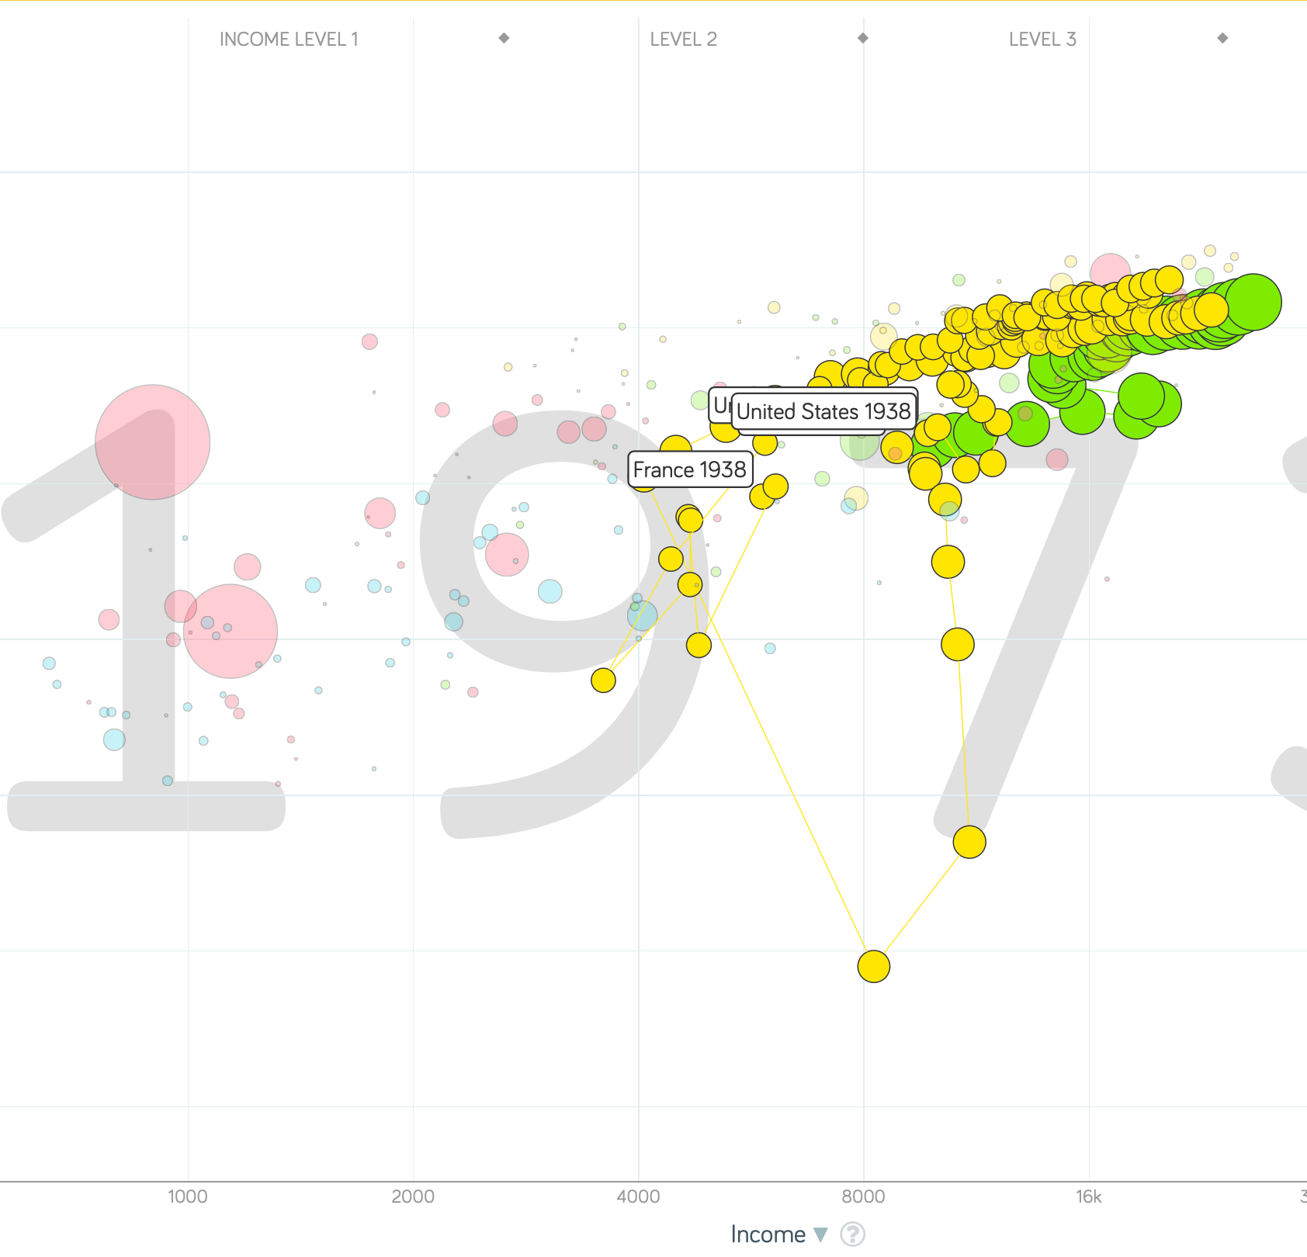
“The West”
1914-1938, 1870-1913, & 1938-1973
Rate of growth in the North Atlantic industrial core halves comparing 1870-1913 to 1914-1938; then triples afterwards over 1938-1973
Slows again after 1973

Slide 29
To Your iClickers
What was the growth rate of ideas in the industrial core of the world economy over 1870-2020?
About 2.3%/year
About 0.9%/year
About 0.23%/year
About 4%/year
None of the above

Slide 30
To Your iClickers
What was the growth rate of ideas in the industrial core of the world economy over 1770-1870?
About 2.3%/year
About 0.9%/year
About 0.23%/year
About 4%/year
None of the above

Slide 31
Review: The Belle Époque Broken
John Maynard Keynes:
“Very few of us realise[d] with conviction the intensely unusual, unstable, complicated, unreliable, temporary nature of the economic organisation by which Western Europe has lived for the last half century. We assume some of the most peculiar and temporary of our late advantages as natural, permanent, and to be depended on, and we lay our plans accordingly.
“On this sandy and false foundation we scheme for social improvement and dress our political platforms, pursue our animosities and particular ambitions, and feel ourselves with enough margin in hand to foster, not assuage, civil conflict in the European family....
“France, Germany, Italy, Austria, and Holland, Russia and Roumania and Poland, throb together, and their structure and civilisation are essentially one. They flourished together, they have rocked together in a war which we, in spite of our enormous contributions and sacrifices (like though in a less degree than America), economically stood outside, and they may fall together…”

Slide 32
Aristocracy & Social Democracy
The aristocrats had rolled the dice:
Europe in 1914 was a Europe of national populations, of industrialists and socialists, of factory workers and technicians…
Europe’s governments in 1914—especially the defense and foreign affairs ministries—had been populated by aristocrats, ex-aristocrats, and would-be aristocrats.
Landed, aristocratic, military elites had control of many of the levers of propaganda and power…
Aristocrats had had help. Industrialists and entrepreneurs were eager to provide their political support in return for economic benefits, as in the 1879 German “marriage of iron and rye”: the imposition of tariffs on imports of British steel (to protect the positions of German manufacturers) and on imports of American grain (to protect the positions of German landlords)…
On the eve of World War I, these landed military service aristocrats, ex-aristocrats, and would-be aristocrats increasingly found themselves members of a social caste that had no societal function…
But power—in the form of office and of vast (if declining relative) wealth—and propaganda—in the form of pageantry and the press—were reinforced by ideologies: Social darwinism…
The aristocrats rolled the dice—and lost…
Social democrats picked up the chips:
Expanded suffrage…
Proportional representation…
“Lands fit for heroes…”
How to provide for the benefits politicians promised?

Slide 33
Reparations, Taxes, and Inflation
Reparations
A peace “without annexations and indemnities”…
But not without reparations…
Two years’ of Germany’s national income demanded:
Much of it “boob bait for the bubbas…” on the part of Allied politicians…
But a powerful shaper of post-WWI Germany
Taxes
High and progressive tax rates…
A powerful impact on inequality…
Class war…
Inflation
U.S.: price level x1.5
Britain: price level x2.0
France: price level x7.0
French government had encouraged investment in Russian bonds…
German: price level x1,000,000,000,000
Austria, Hungary, Czechoslovakia the same…

Slide 34
Keynes’s Protest
Jan Christian Smuts:
“Poor Keynes often sits with me at night after a good dinner and we rail against the world and the coming flood. And I tell him that this is the time for Grigua’s prayer (the Lord to come himself and not to send his Son, as this is not a time for children). And then we laugh, and behind the laughter is [Herbert] Hoover’s horrible picture of thirty million people who must die unless there is some great intervention. But then again we think that things are never really as bad as that; and something will turn up, and the worst will never be. And somehow all these phases of feeling are true and right in some sense…”

Slide 35
Keynes’s Protest II
John Maynard Keynes:
“If we aim deliberately at the impoverishment of Central Europe, vengeance, I dare predict, will not limp. Nothing can then delay for long that final civil war between the forces of reaction and the despairing convulsions of revolution, before which the horrors of the late German war will fade into nothing, and which will destroy... the civilization and progress of our generation…”

Slide 36
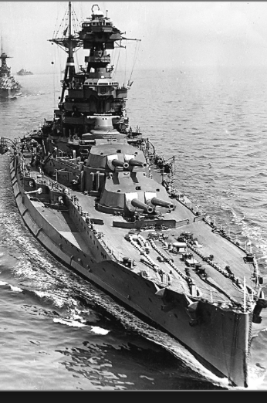
Review: World War I
Nationalism
Max Weber: “The vulgar conception of political economy is that it consists in working out recipes for making the world happy.… However… elbow-room… can [only] be won… through the hard struggle.... That standard of value adopted by a German economic theorist, can… be nothing other than a German policy and a German standard.... Our successors will... hold us responsible... for the amount of elbow-room we conquer.... The science of political economy is... a servant of... the lasting political-power interests of... our nation's power, and the vehicle of that power, the German national state…”
Erich von Manstein: von Manstein, von Lewinsky, Lewinski, Levi…
“We offered 4 battleships a year, the navy demanded 6, and we compromised at 8”

Slide 37
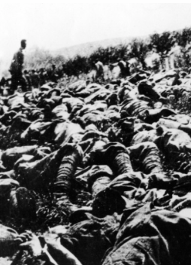
The Catastrophe of World War I: Origins
In the summer of 1914 the empires of Russia and Austria-Hungary are skirmishing diplomatically and threatening each other militarily about the latest Balkan crisis
Began when in the summer of 1914 the Archduke Franz Ferdinand and his wife Sophie were assassinated in Sarajevo
By terrorists with very close links to the intelligence service of the Kingdom of Serbia
What would Austria’s response be?
And then Germany attacks Belgium
And then Australia attacks Turkey

Slide 38
The Catastrophe of World War I: Causes
Why?: “If there is a war, let it come now…”
Russia thought it would have to fight Germany someday, and might as well while France was interested…
Austria, France, Britain (as a result of the German battle fleet) the same
“Busy giddy minds with foreign quarrels…”
A wiser man: Otto von Bismarck:
“There is nothing in the Balkans worth the bones of a single Pomeranian grenadier…”

Slide 39
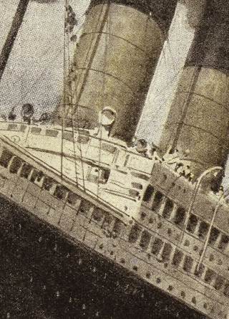
How Does the U.S. Get Involved?
British policy: binding the U.S. upper class to Britain since the 1840s
The Law of the Sea
Neutrals
Blockade
The submarine
Unrestricted submarine warfare
Zimmerman Telegram
Woodrow Wilson
“Teach the Mexicans to elect good men…”
“The war to end war…”

Slide 40
The Catastrophe of World War I: Outcome—Human
Combatants had mobilized 65M out of 100M men of military age
10M killed
10M maimed
Civilian casualties less than 10% of military
Costs of 1.5x a year’s GDP
Plus a 15M global flu epidemic
Russian, Austro-Hungarian, German, Ottoman Turkish Empires all gone…
Representative governments destabilized—or weak…
The Russian Revolution…
Hungarian, Bavarian socialist republics (short-lived)
Spartakist…
Allies demand 2 years of German GDP as “reparations”…

Slide 41
Catch Our Breath…
Comments?
Questions?

Slide 42
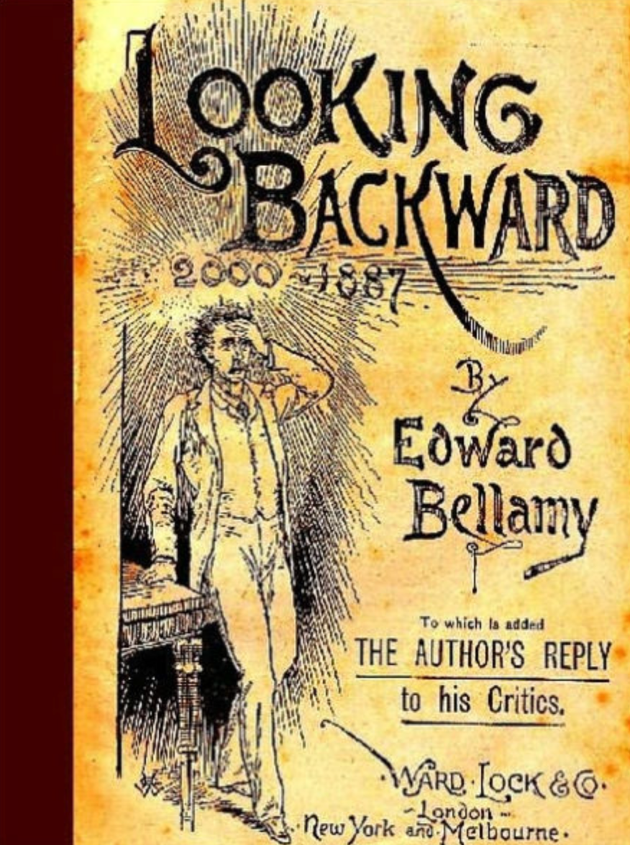
Review: Edward Bellamy: Looking Backward
Edward Bellamy: Looking Backward <https://delong.typepad.com/files/bellamy-backward.pdf>: Perhaps the third best-selling novel of the 19th century in the United States
2000 is a utopia…
The narrator is carried forward in time from 1887-2000 by an implausible plot device:
‘“This is the tenth day of September in the year 2000, and you have slept exactly one hundred and thirteen years, three months, and eleven days…”’
He then wanders around, looking at the utopia of 2000…
The opening:
‘“How could I live without service to the world?” you ask…. The answer is that my great-grandfather had accumulated a sum of money on which his descendants had ever since…. The sum had been originally by no means large. It was, in fact, much larger now that three generations had been supported upon it in idleness, than it was at first…’

Slide 43
The Stagecoach of Society
Those who ride and this who pull:
‘Commiseration was frequently expressed by those who rode for those who had to pull the coach, especially when the vehicle came to a bad place in the road, as it was constantly doing, or to a particularly steep hill. At such times, the desperate straining of the team, their agonized leaping and plunging under the pitiless lashing of hunger, the many who fainted at the rope and were trampled in the mire, made a very distressing spectacle, which often called forth highly creditable displays of feeling on the top of the coach.
‘At such times the passengers would call down encouragingly to the toilers of the rope, exhorting them to patience, and holding out hopes of possible compensation in another world for the hardness of their lot, while others contributed to buy salves and liniments for the crippled and injured. It was agreed that it was a great pity that the coach should be so hard to pull, and there was a sense of general relief when the specially bad piece of road was gotten over. This relief was not, indeed, wholly on account of the team, for there was always some danger at these bad places of a general overturn in which all would lose their seats.
‘It must in truth be admitted that the main effect of the spectacle of the misery of the toilers at the rope was to enhance the passengers’ sense of the value of their seats upon the coach, and to cause them to hold on to them more desperately than before…

Slide 44
The Stagecoach of Society II
“Finer clay”:
‘The other fact is yet more curious, consisting in a singular hallucination which those on the top of the coach generally shared, that they were not exactly like their brothers and sisters who pulled at the rope, but of finer clay, in some way belonging to a higher order of beings who might justly expect to be drawn. This seems unaccountable, but, as I once rode on this very coach and shared that very hallucination, I ought to be believed.
‘The strangest thing about the hallucination was that those who had but just climbed up from the ground, before they had outgrown the marks of the rope upon their hands, began to fall under its influence. As for those whose parents and grand-parents before them had been so fortunate as to keep their seats on the top, the conviction they cherished of the essential difference between their sort of humanity and the common article was absolute. The effect of such a delusion in moderating fellow feeling for the sufferings of the mass of men into a distant and philosophical compassion is obvious.
‘To it I refer as the only extenuation I can offer for the indifference which, at the period I write of, marked my own attitude toward the misery of my brothers…

Slide 45
The Stagecoach of Society III
Class war:
‘The sanguine argued very forcibly that it was in the very nature of things impossible that the new hopes of the workingmen could be satisfied, simply because the world had not the wherewithal to satisfy them. It was only because the masses worked very hard and lived on short commons that the race did not starve outright, and no considerable improvement in their condition was possible while the world, as a whole, remained so poor.
‘It was not the capitalists whom the laboring men were contending with, these maintained, but the iron-bound environment of humanity, and it was merely a question of the thickness of their skulls when they would discover the fact and make up their minds to endure what they could not cure.
The less sanguine admitted all this. Of course the workingmen’s aspirations were impossible of fulfillment for natural reasons, but there were grounds to fear that they would not discover this fact until they had made a sad mess of society. They had the votes and the power to do so if they pleased, and their leaders meant they should. Some of these desponding observers went so far as to predict an impending social cataclysm. Humanity, they argued, having climbed to the top round of the ladder of civilization, was about to take a header into chaos…’

Slide 46
The Limit of Human Felicity I
In the music room:
‘She made me sit down comfortably, and, crossing the room, so far as I could see, merely touched one or two screws, and at once the room was filled with the music of a grand organ anthem; filled, not flooded, for, by some means, the volume of melody had been per- fectly graduated to the size of the apartment. I listened, scarcely breathing, to the close. Such music, so perfectly rendered, I had never expected to hear.
‘“Grand!” I cried, as the last great wave of sound broke and ebbed away into silence. “Bach must be at the keys of that organ; but where is the organ?”…
‘“There are a number of music rooms in the city, perfectly adapted acoustically to the different sorts of music. These halls are connected by telephone with all the houses of the city…. Any one of the four pieces now going on that you prefer, you can hear by merely pressing the button which will connect your house-wire with the hall where it is being rendered…”’

Slide 47
The Limit of Human Felicity III
Four live orchestras you can listen to on the speakerphone!
‘“It appears to me, Miss Leete,” I said, “that if we could have devised an arrangement for providing everybody with music in their homes, perfect in quality, unlimited in quantity, suited to every mood, and beginning and ceasing at will, we should have considered the limit of human felicity already attained, and ceased to strive for further improvements…”’

Slide 48
Review: The View from 3000: Themes & Big Ideas
Science reaches critical mass and from it springs engineering—all of the engineering subdisciplines, including the management of human resources and of organizations. From a liberal political order spring national and then the global market economy. And from engineering and the market, and the large bureaucratic corporation then, over the course of 1870-2016, spring…
History was economic…
Explosion of wealth…
Cornucopia of technology…
Demographic transition…
Feminist revolution…
Inclusion and hierarchy attenuation…
Empowered tyrannies…
Wealth gulfs…
Mismanagement and insecurity…

Slide 49
Measuring Growth
What are my estimates of the rate of growth of economically-useful human knowledge over 1-1500, 1500-1800, 1800-1870, and 1870-2000?
0.02%/year, 0.2%/year, 0.5%/year, and 0.8%/year
0.000%/year, 0.02%/year, 0.2%/year, and 0.8%/year
0.02%/year, 0.2%/year, 0.8%/year, and 2.3%/year
0.2%/year, 0.8%/year, 2.3%/year, and 4.7%/year
None of the above.

Slide 50
What Is the Key Factor in the Explosion of Wealth in the 20th Century?
Yes, many things contributed. But suppose you have to pick just one

Slide 51
What Are the Four Factors That I See as Making for the Explosion of Wealth in the 20th Century?
Yes, there are many, many more things that contributed. But suppose you have to pick just four:

Slide 52
Demography II
What is the principal cause of the demographic transition?
Female wealth and control of property.
Female literacy.
Falling infant and child mortality.
Land shortages and high unemployment.
Something else.

Slide 53
Feminism
How many pregnancies do we think Abigail Smith Adams had between when she was 20 and 34?
2.
4.
6.
8.
18.

Slide 54
Empowered Tyrannies II
How many world leaders are members of the 10-million club?
2.
4.
6.
8.
18.

Slide 55
Inclusion and Hierarchy Attenuation
At the start of the 1970s, future President Ronald Reagan said that diplomats from Tanzania appeared uncomfortable:
resisting pressure to vote with the Soviet Union at the United Nations.
making small talk with New York socialites.
wearing shoes.
in formal tuxedos.
None of the above.

Slide 56
Economic Mismanagement and Insecurity II
According to Karl Polanyi, what rights does the market economy respect?
rights to land (a stable community).
rights to labor (a “just” income).
rights to finance (a stable economic place).
rights to property (the ability to keep what you manage to claim to earn).
None of the above.

Slide 57
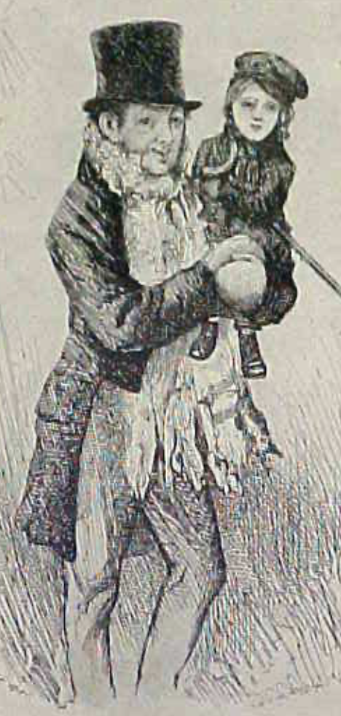
Review: The Watershed: 1870 as an Inflection Point
As of 1870, had the Industrial Revolution raised the standard of living or lightened the toil of the working class in England, the country at its center?
Yes
No
It’s not clear
Why? Malthusian forces—population explosion & thus smaller farm sizes. Growth, the growth had been slow 0.8%/year?

Slide 58
Globalization
Who called the era of globalization and growth from 1870 to 1914 an “economic El Dorado”?
Karl Marx
John Stuart Mill
Thomas Robert Malthus
John Maynard Keynes
None of the above
What would the others have said?

Slide 59
Migration
How many people of the roughly 1.5 billion then-population of the world left their continents of origin between 1870-1913?
10 million
50 million
100 million
200 million
400 million

Slide 60
Before 1870, Ideas Growth Not Fast Enough
And population growth accelerates as the world is not rich enough to undergo the demographic transition:
Value of useful and deployed ideas about technology and organization
-8000: 1
1: 3.5
1500: 4.75
1800: 9
1870: 16
2020: 421
Growth Rates:
-8000 to 1500: 0.02%/year
1500 to 1800: 0.2%/year
1800 to 1870: 0.8%/year
1870 to 2020: 2.3%/year
What caused these accelerations? What caused this last acceleration?

Slide 61
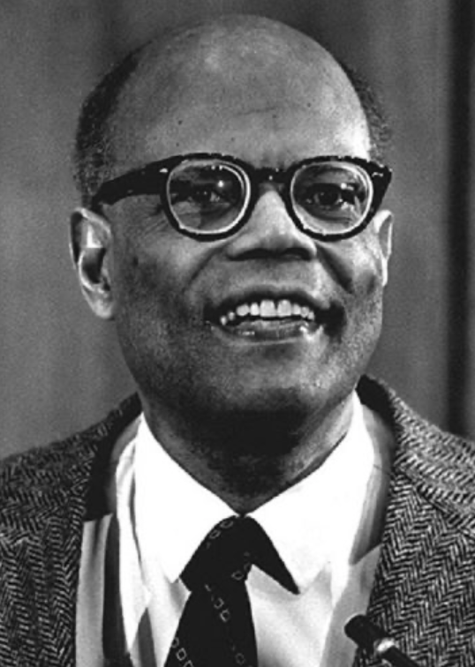
The Last Acceleration
The industrial research lab to routinize invention, and the modern corporation to routinize diffusion and deployment
Plus general purpose technologies—machine tools, non-human power sources
Arthur Lewis:
“New commodities: telephones, gramophones, typewriters, cameras, automobiles, and so on, a seemingly endless process whose latest twentieth-century additions include aeroplanes, radios, refrigerators, washing machines, television sets, and pleasure boats. Thus a rich man in 1870 did not possess anything that a rich man of 1770 had not possessed; he might have more or larger houses, more clothes, more pictures, more horses and carriages, or more furniture than say a school teacher possessed, but as likely as not his riches were displayed in the number of servants whom he employed rather than in his personal use of commodities…”
Not so much the particular technologies, as the grasping of the fact that there was a broad and deep range of new technologies to be discovered.
As much as it was new technologies, it was large-scale corporate organizations that could and did plan the division of labor to make use of and then market technologies.
And as much, it was that the global market meant that there was now a great deal of money to be made from the routinization of the exploration, development, and deployment of technological possibilities

Slide 62
Worldwide: The Broad Sweep
Post-1870 is the miracle:

Slide 63
“The West”
800, 1500, 1770, or 1870?:

Slide 64
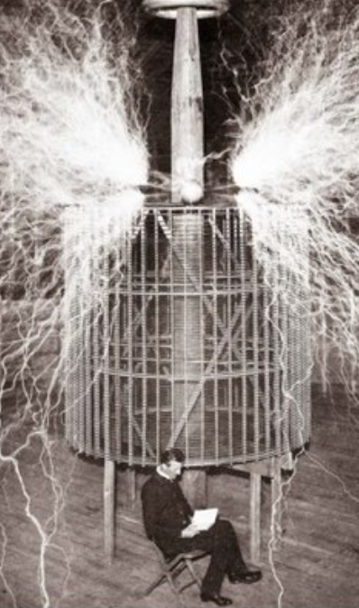
Who Is This Man?
And is he in any real danger?
Thomas Edison, and no
Andrew Carnegie, and no
Nicola Tesla, and no
Thomas Edison, and yes
Herbert Hoover, and yes

Slide 65
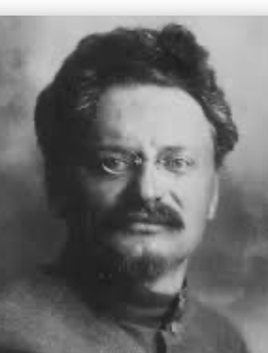
Lev Bronstein
Why did he say this?
“I had had no time to more than catch the general life-rhythm of the monster known as New York…”
“I left for Europe with the feeling of a man who has had only a peek into the furnace where the future is being forged…"

Slide 66

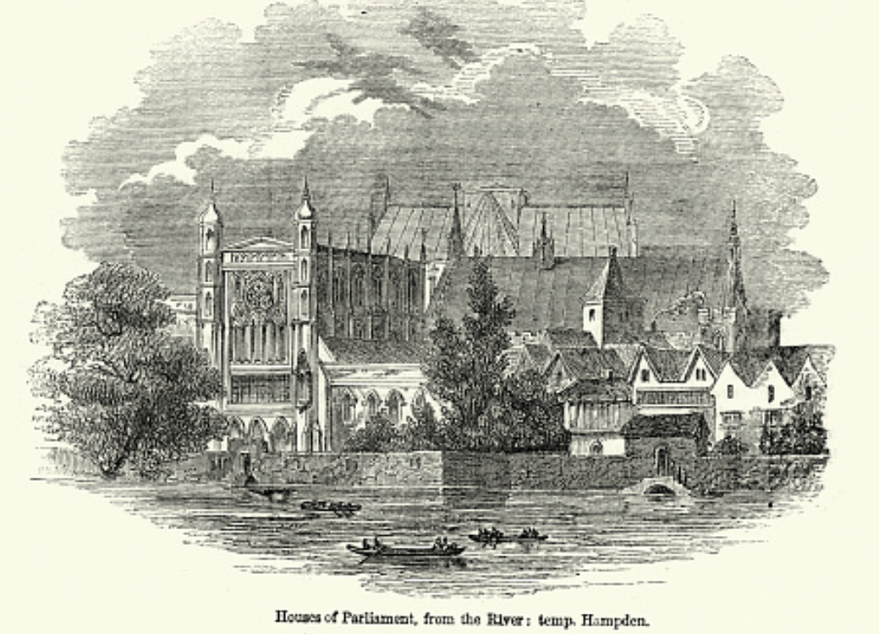
Review: Political Economy
From “Divine Right” and “Natural Order” to Enlightenment values…
Who was the first person to draft these words:?
“We hold these truths to be sacred & undeniable:
that all men are created equal & independant,
that from that equal creation they derive rights inherent & inalienable,
among which are the preservation of life, & liberty, & the pursuit of happiness;
that to secure these ends, governments are instituted among men, deriving their just powers from the consent of the governed…”
John Locke
Niccolo Machiavelli
Thomas Hobbes
Thomas Jefferson
George Washington
Why did he write them?

Slide 67
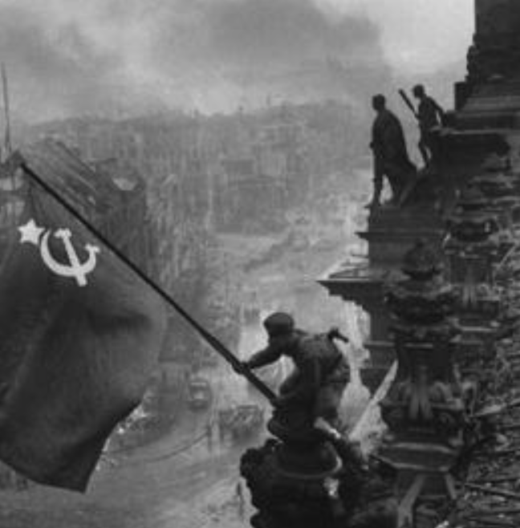
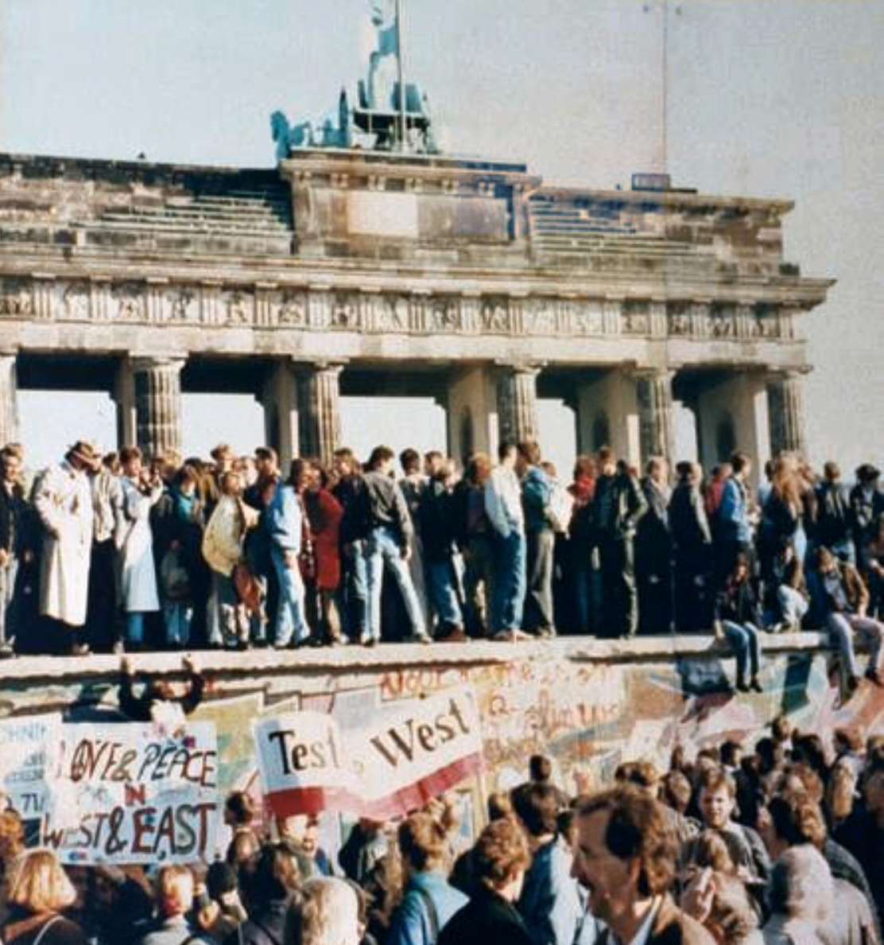
What Was the Proper Political Order?
Fears of “democracy” among American founders:
Madison: “Democracies have ever been spectacles of turbulence and contention... incompatible with personal security or the rights of property... as short in their lives as... violent in their deaths…”
Jefferson: “Gen’l Washington had not a firm confidence in the durability of our government… [& this] had some weight in his adoption of… ceremonies… calculated to prepare us gradually for a change which he believed possible…”
Hamilton: “the British government… best” as the only one “unit[ing] public strength with individual security…”
Adams: The American president should be announced as: “His Highness, the President of the United States, and Protector of the Rights of the Same…”
Question of political order thought settled: first in the rubble of Berlin in 1945, and then in the streets of East Germany in 1991:
Settled in favor of representative democracy, private property, & social insurance—late-1900s liberal democracy
But now reopened? Min Zhu (朱民) to me in 2015: “What are you Americans going to do to fix your broken political system?”

Slide 68
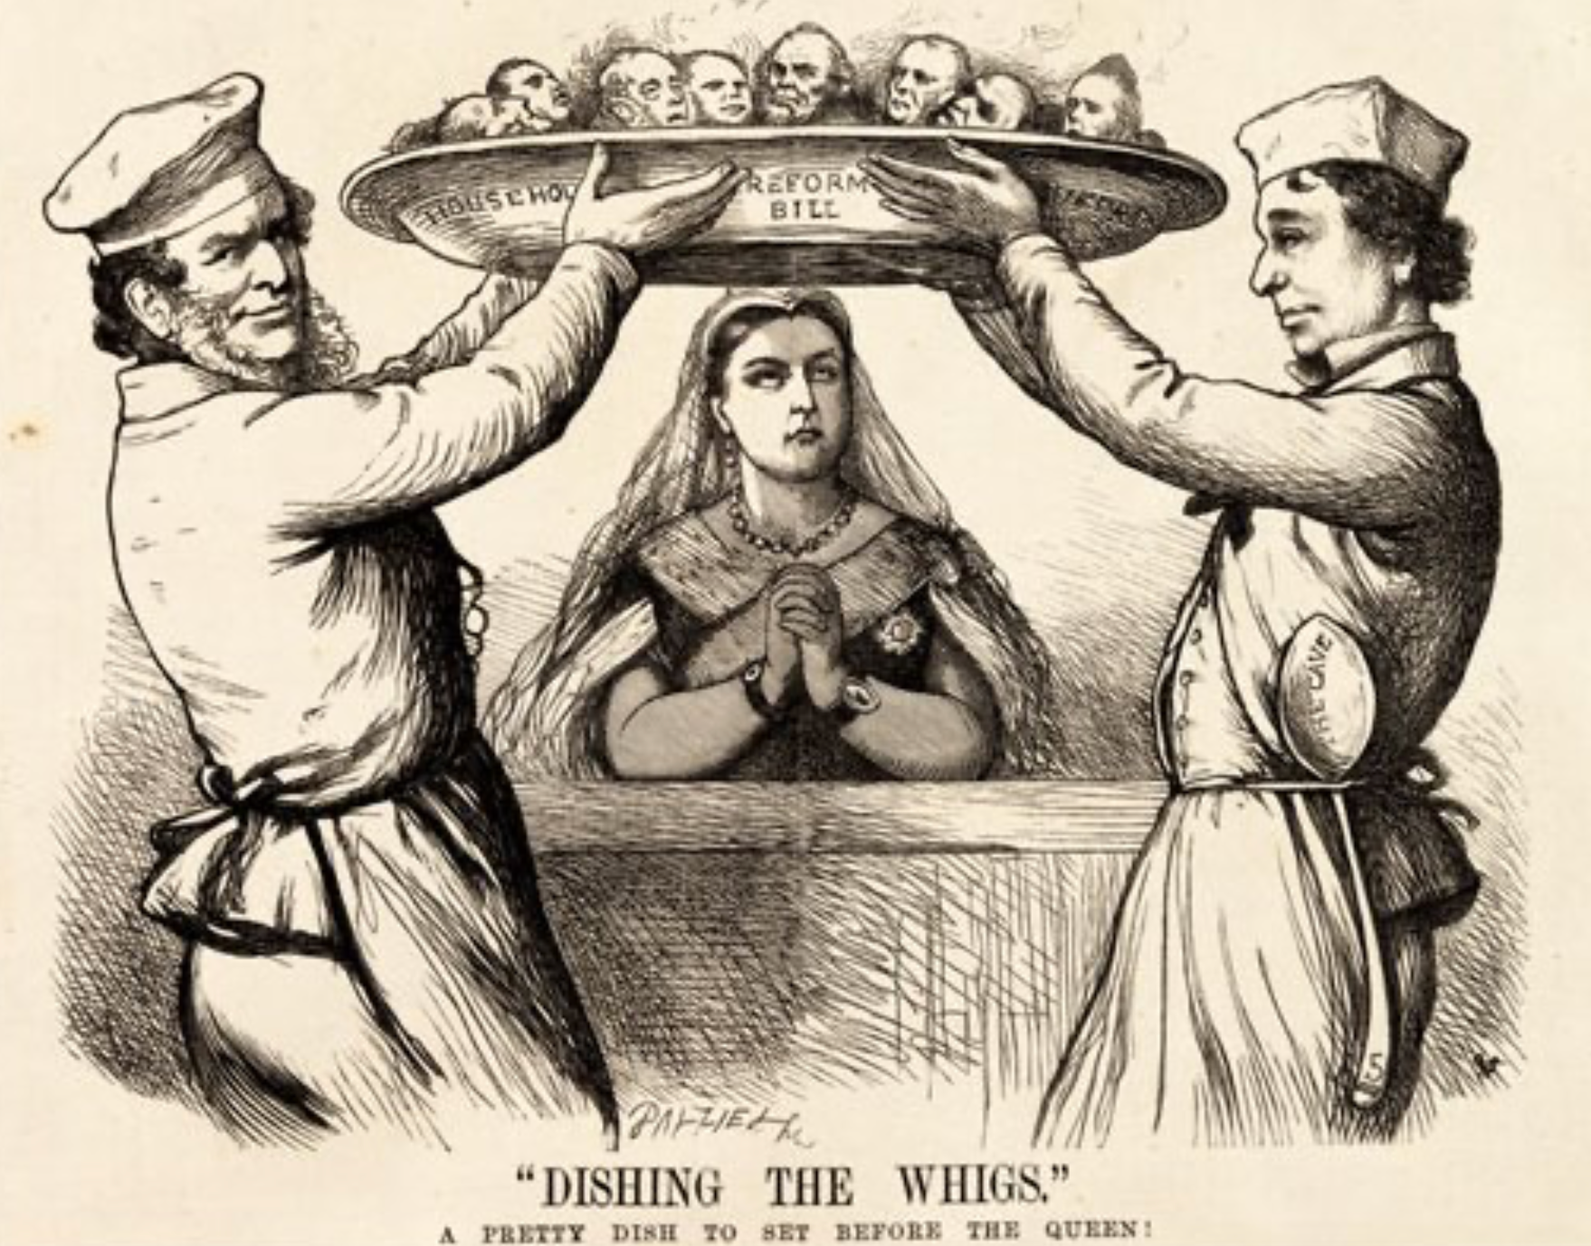
Franchise Restricted to the Rich Could Not Maintain Itself
The dynamic of franchise extension
Liberals in power would try extend on the principle that the new, poorer voters would be less conservative and would support them.
Threatening revolution would lead even conservatives to seek to extend the franchise in order to peel off of the revolutionary coalition those of the disenfranchised who had the most social power:
Earl Grey (yes, the tea): “The Principal… is to prevent… revolution…. I am reforming to preserve, not to overthrow…”
Charismatic leaders with popular followings would seek to give them votes, and then rule via plebiscites—going around the traditional elites
(Peculiar thing about Trump-Johnson: minority, and core is a minority of a minority…)
Conservatives: “dish the Whigs”—opportunities to form winning coalitions by appealing to those who were no profiting from the market economy, or felt that they were losing relative status in some ways…

Slide 69
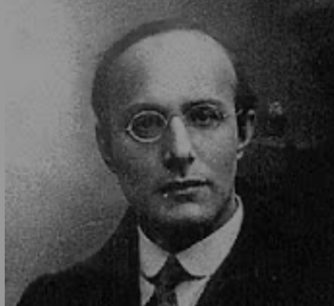
Popular Government and the Market Economy: Society’s Revenge
Karl Polanyi
People believe they have rights—to stable, supportive, nurturing communities; to incomes commensurate with their skills and status; and to money flows that will provide economic stability…
But a market society turns these things—land, labor, and finance—into commodities…
But they are not real commodities, they are fictitious commodities
And so you get your rights only if they satisfy a market profitability test
The only rights a market society respects are property rights:
& the only property rights that are worth anything are those that help you produce things for which rich people have a serious jones
Society will have its revenge: it will protect itself against the market logic, somehow, some way…

Slide 70
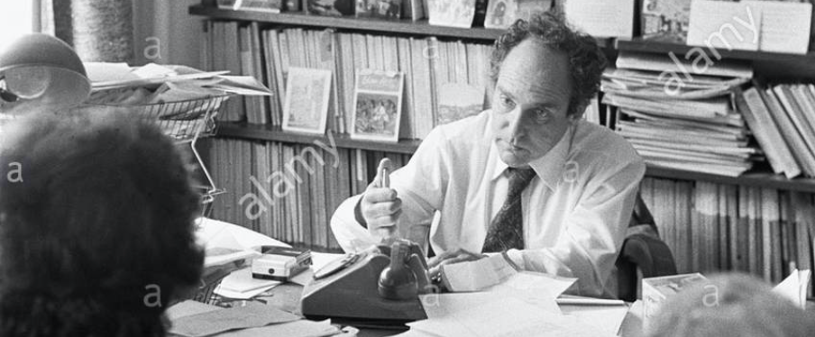


Digression: 5 Thinkers
Who shape my thought about the long 20th century—and how should, I think, shape yours
Beware! They are all deeply flawed…
But they are also geniuses, each in his way…
Beware of their followers! An iron law of ideology: a thinker’s most extravagant and aggressive followers will latch onto the stupidest and most shortsighted and wrong of their doctrines…
In historical order: Marx, Keynes, Hayek, Polanyi, Gellner
The other three thinkers:
Keynes: All that we need to produce general prosperity is technical adjustments to our system. Then the kingdom of freedom and prosperity will be within our grasp—and our major problems will no longer be economic ones
Gellner: The energy that most 19th century thinkers thought would go to “class“ went to “ethnos“ or “umma“ instead. The construction of ideological legitimations that makes sense both to dominants and to submissives who nevertheless believe they are part of some in-group is the key to understanding how societies stabilize themselves
Marx: Only the market economy will focus society’s energy on paying through the nose to boost the economy’s capital stock and to harvest the fruits of science and technology and then deploy them in production. But because the only demands in a market economy that matter are effective demands, the market economy also becomes a more “effective” means of slavery, for private property leads the proletariat to enslave themselves

Slide 71
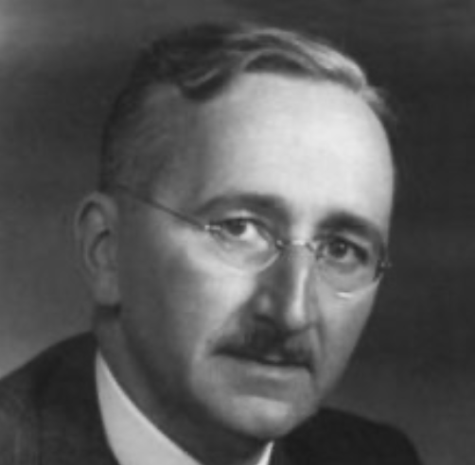
Hayek and Polanyi
Thumbnails on our first two:
Hayek:
Only the market economy can use society’s knowledge.
But the market economy cannot produce “social justice” and should not be asked to try—in fact, we need to recognize that all we can attain is freedom, and that will bring general prosperity, but that justice will be forever outside our reach
Polanyi:
The market economy turns land, labor, and finance into “fictitious commodities”
Society will have its revenge via a “double movement”

Slide 72
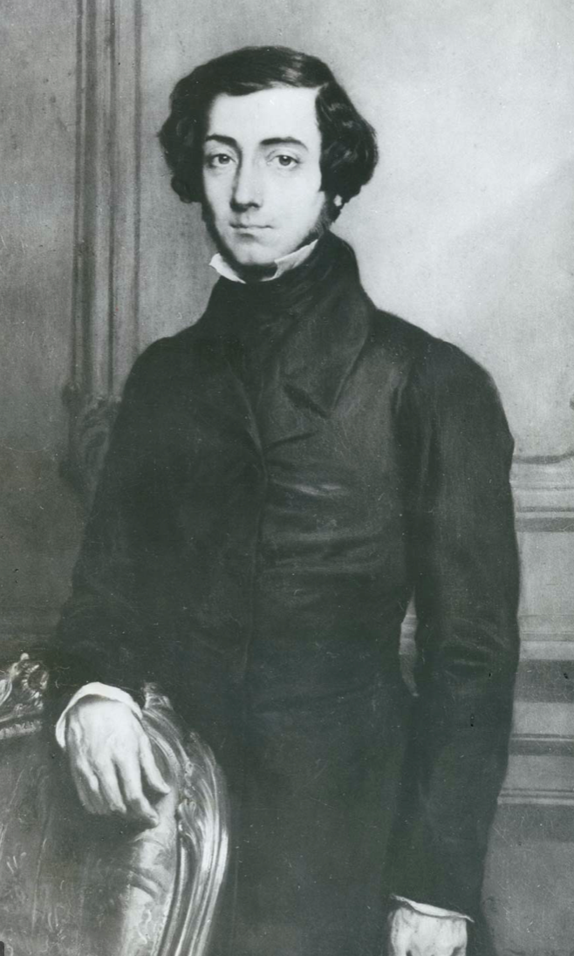
Plus Tocqueville
Toqueville on the rich as “elder brothers” in 1848:
“In the country all the landed proprietors, whatever their origin, antecedents, education or means, had come together, and seemed to form but one class: all former political hatred and rivalry of caste or fortune had disappeared from view. There was no more jealousy or pride displayed between the peasant and the squire, the nobleman and the commoner; instead, I found mutual confidence, reciprocal friendliness, and regard. Property had become, with all those who owned it, a sort of badge of fraternity. The wealthy were the elder, the less endowed the younger brothers; but all considered themselves members of one family, having the same interest in defending the common inheritance. As the French Revolution had infinitely increased the number of land-owners, the whole population seemed to belong to that vast family. I had never seen anything like it, nor had anyone in France within the memory of man…”
“The territorial aristocracy of past ages… [was] obliged… to come to the help of its servants and relieve their distress” no such reciprocal ties of obligation bound the aristocrats of manufactures to their workers: thus “the manufacturing aristocracy which we see rising before our eyes is one of the hardest that have appeared on the earth…”

Slide 73
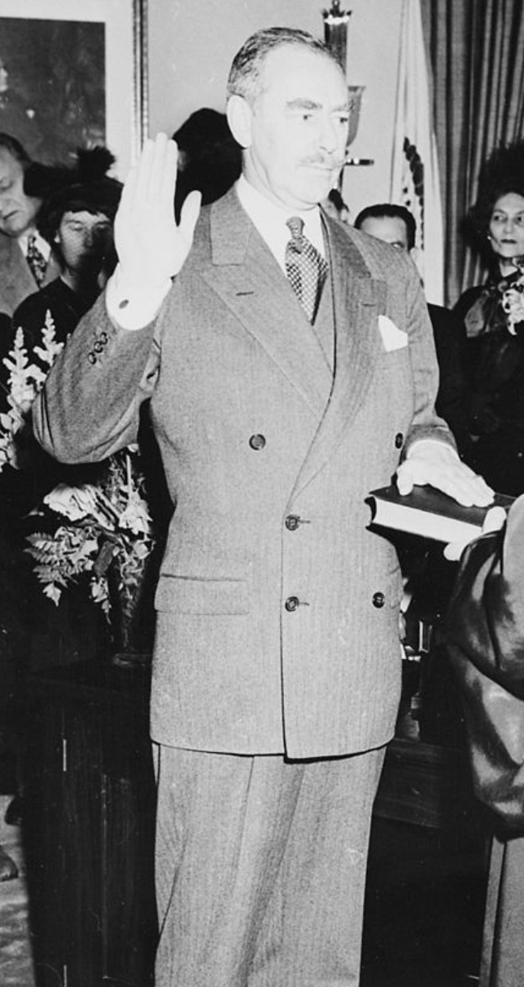
Plus Acheson
Dean Acheson, Secretary of State for Harry S Truman:
On the Republican Party as the party of wealth, enterprise, and opportunity:
“This business base of the Republican Party is stressed not in any spirit of criticism. The importance of business is an outstanding fact of American life. The achievements of business have been phenomenal. It is altogether appropriate that one of the major parties should represent its interests and its point of view…”
The subsequent transformation of the Republican Party from those who were going to become millionaires, or become even greater millionaires; to those who fear that they would lose it all…

Slide 74
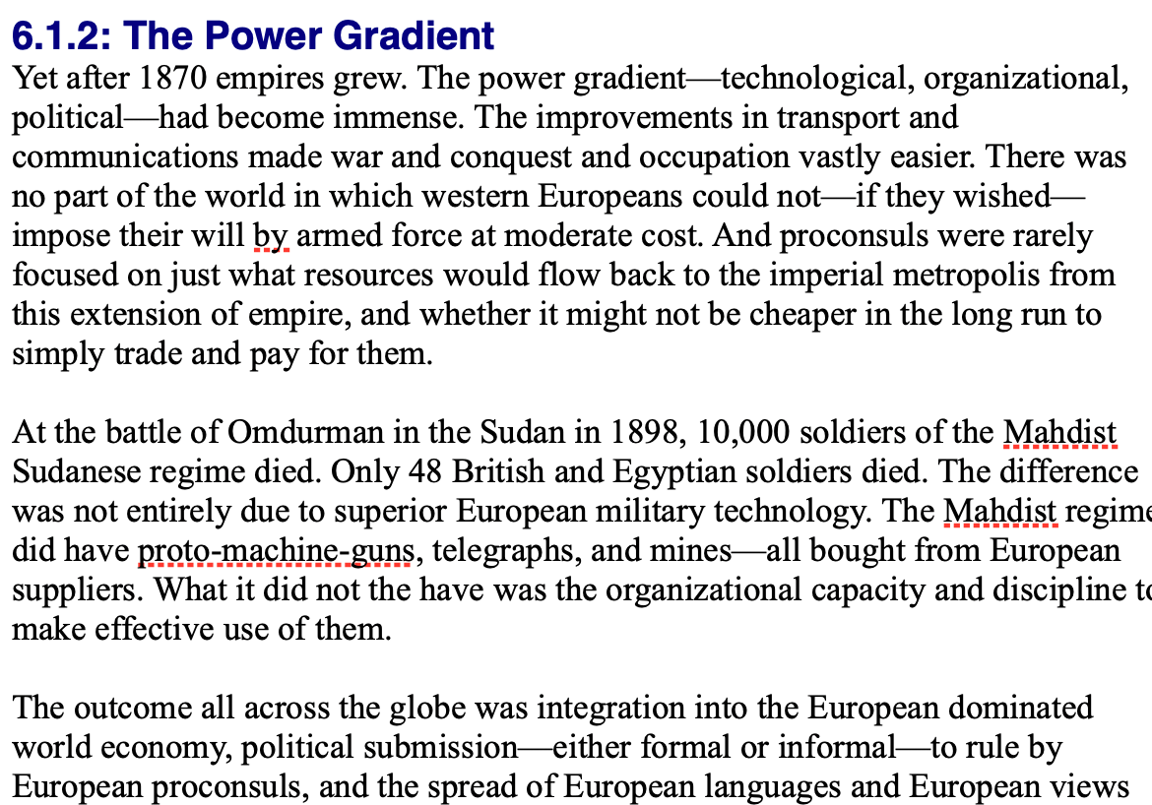
Review: Empire
By 1810 the tide of empire had been clearly ebbing…
But then things turned around: the power gradient:

Slide 75
To Your iClickers!
According to Eichengreen, graphing international capital flows and mobility since 1850 over time produces a graph that is:
V-shaped
U-shaped
W-shaped
An upward line
None of the above

Slide 76
To Your iClickers!
According to Eichengreen, the responsibilities of a pre-World War I central bank as steward of the global gold standard and also as lender-of-last-resort in domestic financial crises were:
in complete harmony
in irresolvable tension
for the most part manageable, before World War I at least, via fancy footwork and good luck
not understood
none of the above

Slide 77
To Your iClickers!
According to Eichengreen, the experience of being on the gold standard for North Atlantic economies in the 1870-1914 period was by and large a happy one, and the experience of countries at the world economy’s periphery was:
also by and large a happy one.
a mixed one.
a source of considerable tension, instability, and political upset.
once again, manageable with fancy footwork and a little good luck.
none of the above.

Slide 78
To Your iClickers!
In Eichengreen’s view, if World War I had somehow been avoided, would the global gold standard have remained stable in the 1920s and 1930s?
There are no guarantees, but probably yes.
There are no guarantees, but probably no.
Certainly not!
Certainly yes—unless several North Atlantic economies experienced a socialist revolution
None of the above.

Slide 79
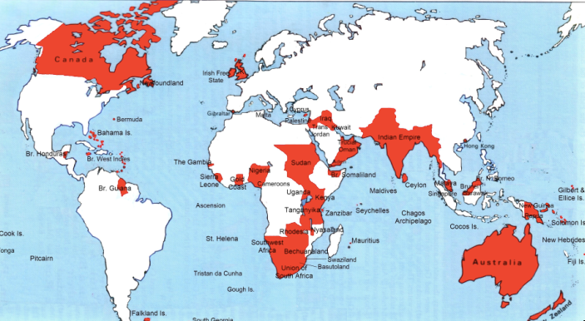
Empire

Slide 80
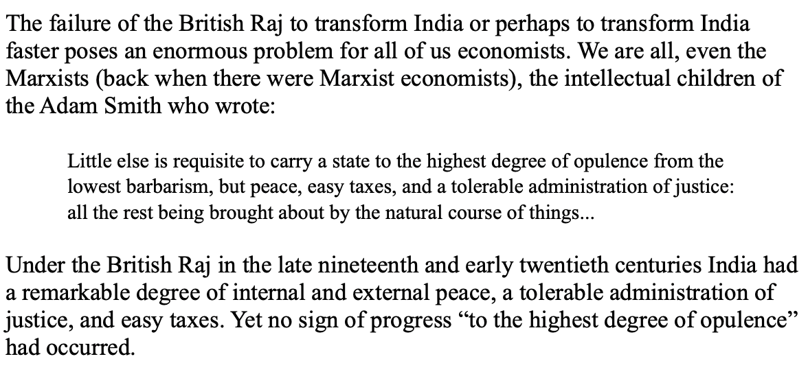
India
Why didn’t the British transform India into an industrial power?

Slide 81
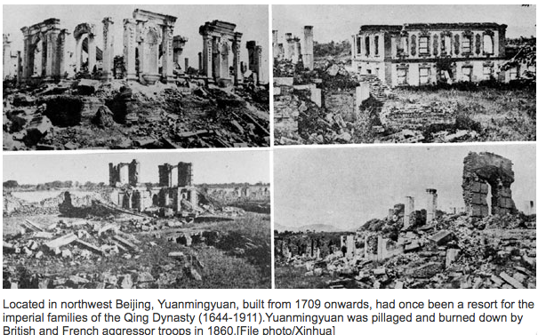
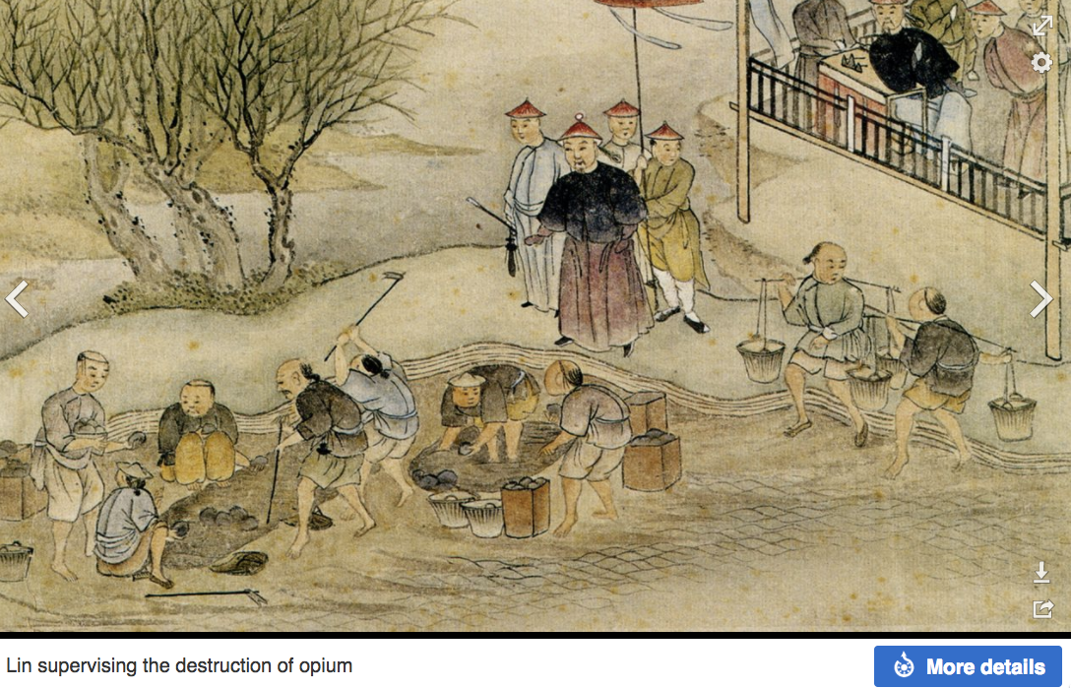
“Self-Strengthening”
The puzzle of China vs. Japan
Great Qing (大清)(1644-1912)
Wu Sangui (吳三桂)
The Rebellion of the Three Feudatories (三藩之亂)
Kangxi and Qianlong: “revere the emperor and expel the barbarians” is difficult to pursue when the emperor and his clan identify themselves as “barbarians”
Tai-Ping Rebellion (太平天國運動)
Cixi ( 慈禧太后)
Li Hongzhang (李鴻章)the Kai-Ping coal mine, Chang Yen-Mao, and Herbert Hoover

Slide 82
Formal Empires
There were, broadly, three views as to why European late-1800s empires rose to such domination, each of which with its own view of what was to be done to fix the situation:
One view is that of John Hobson: The major economic problem was the business cycle. Equipping the military needed to maintain the empire puts people to work. And an empire is a good source of consumers for the products of domestic factories. European governments that pursued empire, Hobson thought, were less likely to face economic distress and so more likely to continue in office.
A second view was that of Joseph Schumpeter: imperialism as the last gasp of military status aristocracy.
The third view was that empires were ordained by God—or at least morally required or desirable, for European powers had a civilizing mission. The Europeans were lucky enough to be the grownups, and it was the obligation of the grownups to civilize the world. But perhaps civilization is best spread by newspapers and books and merchants and engineers, rather than by alien proconsuls? Just a thought.

Slide 83
Informal Empires
But even where Britain (or France, or Germany, or Portugal, or Spain, or those who thought of themselves as descended from the conquistadores of Castile, or Anglo-Saxon settlers) did not rule, they reigned:
Britain seemed successful: playing by Britain’s rules seemed wise…
Britain was powerful: playing by Britain’s rules seemed likely to keep it from getting annoyed…
Britain was working very hard to make itself attractive—to make becoming a Briton-by-proxy of some sort straightforward and profitable in both money and cultural terms…
Britain was the first-mover hegemon: international cooperation was on its terms…

Slide 84
Catch Our Breath…
Comments?
Questions?

Slide 85
Review: Revolutions
“Petty Officer Lemmgen… arrived at the Ministry [of War]… found… Lieutenant HambuRger.... Lemmgen produced a typed document with the following text: ‘Comrades and Workers! The Ebert-Scheidemann government have made themselves impossible.... The undersigned Revolutionary Council has provisionally assumed power.’
“Lieutenant Hamburger inspected the document and became properly indignant. ‘But where are the signatures? Before I can comply with this order, you’ll have to go back and get it properly signed. Otherwise any little shorthand typist could declare the government deposed.’ Petty Officer Lemmgen... saw the logic…. So he and his men saluted... and made their way back to the Revolutionary Council to obtain the necessary signatures....
“But by the time he had obtained the signatures, Lemmgen had learned that the People’s Naval Division had declared itself neutral. So he did not return to the Ministry of War…”

Slide 86
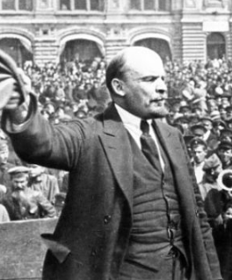
Lenin
A quick power grab…
Confidently expecting a German revolution, and then massive aid…
Brutal civil war
Kerenskyites
Reds
Whites
Nationalists
What was the revolutionary government to do?
Ludendorff’s German war economy…

Slide 87
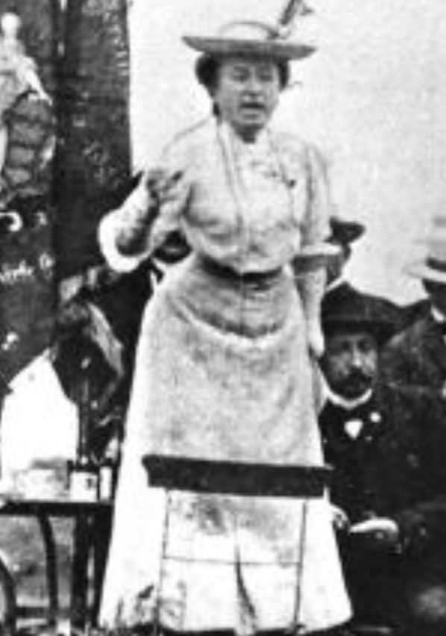
Red Rosa on Lenin
“Without general elections, without unrestricted freedom of press and assembly, without a free struggle of opinion, life dies out in every public institution…. Only the bureaucracy remains…. A few dozen party leaders of inexhaustible energy and boundless experience direct and rule….
“An elite of the working class is invited from time to time to meetings where they are to applaud the speeches of the leaders, and to approve proposed resolutions unanimously–at bottom, then, a clique affair…. Such conditions must inevitably cause a brutalization of public life: attempted assassinations, shooting of hostages, etc…
“Freedom only for the supporters of the government, only for the members of one party–however numerous they may be–is no freedom at all. Freedom is always and exclusively freedom for the one who thinks differently. Not because of any fanatical concept of “justice” but because all that is instructive, wholesome and purifying in political freedom depends on this essential characteristic, and its effectiveness vanishes when ‘freedom’ becomes a special privilege…

Slide 88

Review: The U.S.: The Roaring Twenties
The boom of the 1920s
Mass production—the flowering of the Second Industrial Revolution
“The business of America is business”
Structural changes in the 1920s…

Slide 89
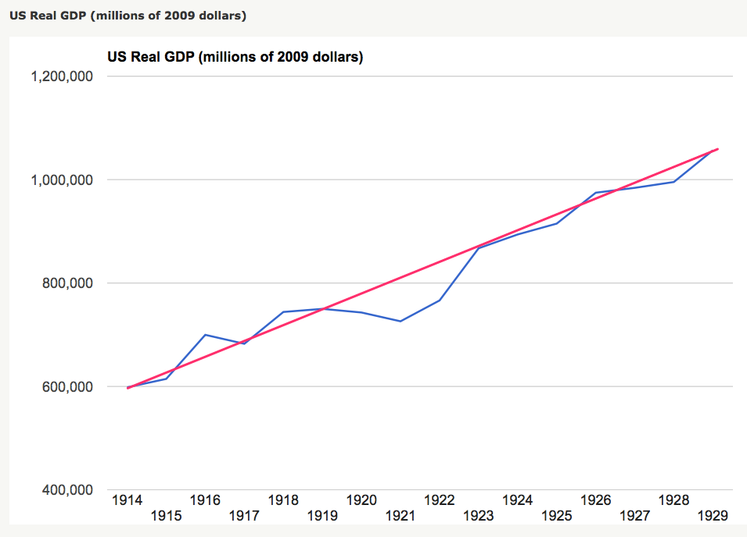
Structural Changes in the 1920s
Mass production—Henry Ford and the Model T
End of mass immigration—immigration restrictions of 1924
What do these do to the demand for construction, and construction workers?
The role of the stock market…
The role of the banking system…

Slide 90
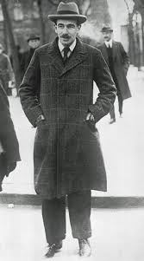
Review: To Your iClickers
John Maynard Keynes thought that the prosperity of the pre-WWI years was:
Natural and stable: a logical development out of human drives that went from strength to strength, and could only be overthrown by a very unlikely disaster.
Artificial and unstable, and based on a very complicated system in which, largely by chance, a lot happened to go right.
Natural but unstable, in that it was a logical development out of humanity’s trading nature but could be disturbed by other human drives—like tribalism, and the lust for domination.
Artificial but stable, as constructed by the greatest minds of the age, and only overthrown by a very unlikely disaster.
None of the above

Slide 91
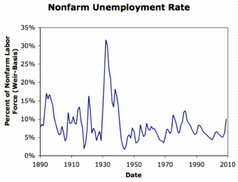
Review: Why the “Perfect Storm” of 1929-1933?
Previous Cycles:
1873—railroad
1884—railroad redux
1893—free silver
1904—Northern Securities
1907—gold drain to Britain
1914—disruption of the start of WWI
1920—deflation; return to “normalcy”
What brought previous downturns to a halt?
What made the Great Depression so great?

Slide 92
General Glut
How is it that there can be a "general glut" in which pretty much every produced commodity and the labor of workers are in excess supply, given that humans are far from satiated with production goods and given that one person's expenditure is another person's income?
Remember: you can take your income and use it either to buy things that are useful or to build up your stock of cash money. If there is excess demand for useful commodities, people can switch from producing whatever they were making to producing whatever is in short supply.
But the only way to build up your stock of cash is to try to cut your spending below your income. And since one person's spending is another person's income, that simply cannot be done in general.
If people in general try, the result is that spending and incomes fall economywide until they are both at such a low level that people de-prioritize building up their cash holdings.

Slide 93
What Had Ended Previous Downturns?
Previous Cycles:
1873—RR investment drops to zero
1884—RR investment drops to zero
1893—confidence that gold standard will be kept
1904—Theodore Roosevelt
1907—J.P. Morgan constitutes himself a pick-up central bank
1914—profits from European war demand WWI
1920—Federal Reserve reverses course

Slide 94
Interwar Gold Standard
The interwar gold standard caused, deepened, and definitely did nothing toward curing or ameliorating the Great Depression?
There is nothing worse than attempting to credibly commit to an incredible policy
The fear that the gold standard would break down caused people to want to hoard cash—to build up their cash holdings.
The fear that the gold standard would break down caused governments to be extremely unwilling to boost their economies' cash supplies—such boosts might, governments feared, undermine confidence that their country would stay on the gold standard.
Big depressions happen when the popular demand for cash outstrips the government's supply
The interwar gold standard was thus a powerful motivator and stage-setter pushing both people and governments into the patterns of behavior that produced the Great Depression

Slide 95
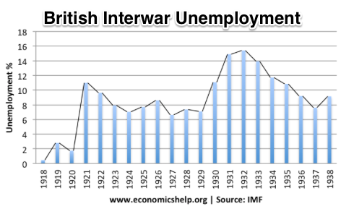
“Crying ‘Fire! Fire!’ in Noah’s Flood…”
France gold acquisition policy
American gold acquisition policy
The weakness of the gold-exchange standard—that people knew the gold standard could and would be abandoned
Labor-side pressure…
Nothing worse than an attempt to credibly commit to an incredible policy…
And then the belief that inflation was always just around the corner…

Slide 96
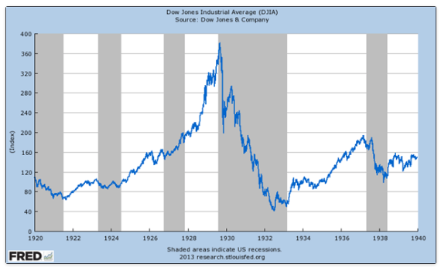
The Role of the Stock Market
Stock market doubles between the start of 1927 and late 1929
Positive-feedback margin trading
And a large number of people coming into the market who do not understand what is going on
Castles in the air
Prohibition?
Monetary policy?
Mass production?
The expectations shock produced

Slide 97
Why Was the Great Depression so Great?
John Maynard Keynes:
“When once the recovery has been started, the manner in which it feeds on itself and cumulates is obvious. But during the downward phase, when both fixed capital and stocks of materials are for the time being redundant and working-capital is being reduced, the schedule of the marginal efficiency of capital may fall so low that it can scarcely be corrected, so as to secure a satisfactory rate of new investment, by any practicable reduction in the rate of interest.
“Thus with markets organised and influenced as they are at present, the market estimation of the marginal efficiency of capital may suffer such enormously wide fluctuations that it cannot be sufficiently offset by corresponding fluctuations in the rate of interest. Moreover, the corresponding movements in the stock-market may, as we have seen above, depress the propensity to consume just when it is most needed. In conditions of laissez-faire the avoidance of wide fluctuations in employment may, therefore, prove impossible without a far-reaching change in the psychology of investment markets such as there is no reason to expect.
“I conclude that the duty of ordering the current volume of investment cannot safely be left in private hands….”

Slide 98
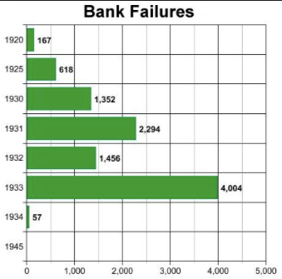
The Role of the Banking System
In the United States in the 1920s, about 600 banks failed a year—largely small rural banks
But banks set out to make riskier and riskier loans
Do they count on rescue from the Federal Reserve?
And when the Great Depression hits, bank failures rise to previously-unimaginable heights
Is there anything that could do more to boost the demand for or reduce the supply of cash?
And so call forth a general glut?
Lenders of “last resort”?

Slide 99
The Presumption Before the Great Depression
The presumption before the Great Depression that the government was not responsible for managing and curing the business cycle…
Two strands reinforced each other.
The first was the strength of the idea of laissez-faire: that government (protecting property and enforcing contracts aside) was overwhelmingly a problem and not a solution. As John Maynard Keynes wrote in his essay The End of Laissez-Faire, a powerful drive behind that was: “the corruption and incompetence of eighteenth-century government…. Almost everything which the State did in the eighteenth century in excess of its minimum functions was, or seemed, injurious or unsuccessful. [And] on the other hand, material progress between 1750 and 1850 came from individual initiative…”
The second was social Darwinism—that, in the words of steelmaster Andrew Carnegie, the second-richest man in America circa 1905 and a man who gave away his entire fortune: “The price we pay for [our civilization]... is, no doubt, great.... The employer of thousands is forced into the strictest economies... [in] the rates paid to labor.... The law of competition... is here; we cannot evade it; no substitutes for it have been found; and while the law may be sometimes hard for the individual, it is best for the race, because it insures the survival of the fittest in every department..."
The result was a dominant belief—at least among the rich and powerful—that:
The market giveth, the market taketh away: blessed be the name of the market.

Slide 100
The Hoover Administration’s Reaction to the Great Depression
The 1929-1933 Hoover administration believed that little could be done.
That the only good things that could be done were to (a) repeatedly state that "prosperity is just around the corner" and (b) try to cut federal government spending and raise taxes in order to restore confidence and scotch the fear of high inflation.
As economist R.G. Hawtrey wrote, to worry about inflation in the midst of the Great Depression was like "crying 'FIRE! FIRE!' in Noah's Flood..."
Herbert Hoover himself wrote afterwards about how his administration had been dominated by the "'leave-it-alone liquidationists' headed by Secretary of the Treasury Mellon, [who] felt that government must keep its hands off and let the slump liquidate itself. Mr. Mellon had only one formula:
'Liquidate labor, liquidate stocks, liquidate the farmers, liquidate real estate'. He held that even panic was not altogether a bad thing. He said: 'It will purge the rottenness out of the system. High costs of living and high living will come down. People will work harder, live a more moral life. Values will be adjusted, and enterprising people will pick up the wrecks from less competent people'…"
Hoover went on to state that he did not share this view…
That raises lots of questions about how his administration worked…

Slide 101
To Your iClickers
The largest automobile manufacturer in the world in 1928 was:
Toyota
Daimler-Benz
Peugeot
Ford
General Motors

Slide 102
To Your iClickers…
Worldwide, the Great Depression was was:
In relative terms, equalled by the Cleveland Depression of 1893-6
In relative terms, smaller than the depression that followed the Crash of 1873
In relative terms, equalled by the Great Recession of 2008-2020
In relative terms, by far the largest depression ever
None of the above

Slide 103
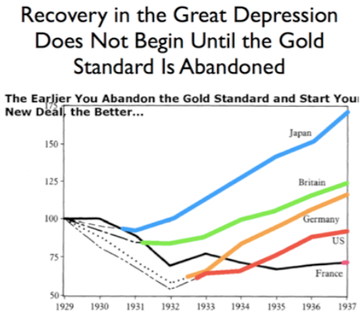
Review: New Deals
Japan: Takahashi Korekiyo
moved early to maintain full employment
Britain: MacDonald-Snowden-Baldwin
Forced off…
Germany: Adolf Hitler
Succeeds Bruening
America: Franklin Delano Roosevelt
Succeeds Herbert Hoover
France: Leon Blum

Slide 104
Recovery
Japan recovered the fastest,
Germany second,
Britain third,
The U.S. fourth,
France last.
By-and-large, the sooner you abandon the gold standard, expand the money supply, and undertake a "New Deal" to boost government spending, the better…

Slide 105
The Polanyian Perplex
People believe that the rights they have are broader and deeper than simply property rights, but the market economy disagrees.
Thus either governments will find a way to guarantee their populations these extra rights to community stability, general prosperity, and full employment, or society will react somehow against the liberal market-oriented political-economic system.
“Fictitious commodities”:
Land
Labor
Finance
Society’s “double movement”

Slide 106
The Permanent Problem of the Human Race
John Maynard Keynes thought that the economic problem would not be the "major problem of the human race"
By the end of the twentieth century the human race would be so rich that people would be practically satiated with commodities.
Thus the "economic problem" of how to economize and be efficient, and allocate scarce means among alternative uses, was not the permanent problem of the human race.
Instead, "for the first time since his creation man will be faced with his real, his permanent problem-how to use his freedom from pressing economic cares, how to occupy the leisure, which science and compound interest will have won for him, to live wisely and agreeably and well.... It will be those peoples, who can keep alive, and cultivate into a fuller perfection, the art of life itself and do not sell themselves for the means of life, who will be able to enjoy the abundance when it comes..."
Yet Keynes was not sure that having to confront this problem would be a net plus for humanity: "Will this be a benefit? If one believes at all in the real values of life, the prospect at least opens up the possibility of benefit. Yet I think with dread of the readjustment of the habits and instincts of the ordinary man, bred into him for countless generations, which he may be asked to discard within a few decades..."

Slide 107
Digression: How to Study
Will I ask you about Jan Christian Smuts? About the prayer (and theology) of the Grigua?
No…
Themes and concepts…
But you need narratives and stories to hang onto them…
And our brains are very good at deep-sixing useless information
Andy Matuschak: Why Books Don’t Work <https://andymatuschak.org/books/>:
“Picture some serious non-fiction tomes. The Selfish Gene; Thinking, Fast and Slow; Guns, Germs, and Steel; etc.
“Have you ever had a book like this—one you’d read—come up in conversation, only to discover that you’d absorbed what amounts to a few sentences? I’ll be honest: it happens to me regularly. Often things go well at first. I’ll feel I can sketch the basic claims, paint the surface; but when someone asks a basic probing question, the edifice instantly collapses. Sometimes it’s a memory issue: I simply can’t recall the relevant details. But just as often, as I grasp about, I’ll realize I had never really understood the idea in question, though I’d certainly thought I understood when I read the book. Indeed, I’ll realize that I had barely noticed how little I’d absorbed until that very moment. I know I’m not alone here…

Slide 108
Skipped Topic: Pre-1914 Political Economy: Over in Europe
The June Days of 1848 in Paris:
Tocqueville:
“The insurrection of June [1848]... class against class... a blind and rude, but powerful, effort on the part of the workmen to escape from the necessities of their condition, which had been depicted to them as one of unlawful oppression…. The closing of the national workshops… occasioned the rising…”
“Thousands… hastening to our aid from every part of France.... Thanks to the railroads, some had already come from fifty leagues’ distance... every class of society... peasants... shopkeepers... landlords and nobles all mingled together... they rushed into Paris with unequalled ardour: a spectacle as strange and unprecedented in our revolutionary annals.... The insurgents received no reinforcements, whereas we had all France for reserves…”

Slide 109
French Politics
Régimes stability is not on the menu:
the terrorist dictatorship of the Jacobins (the mainspring of popular government… amid revolution it is at once virtue and terror: virtue, without which terror is fatal; terror, without which virtue is impotent…)
a corrupt and gerrymandered 5-man executive of the Directory, defended on October 5, 1795 by the “whiff of grapeshot” of Napoleon Bonaparte and Joachim Murat, that managed to generate the first modern hyperinflation, defended itself against a royalist coup plotted by two of its five members (Barthelemy and Carnot) and its most successful general (Pichegru), and was then overthrown by the same Napoleon in 1799.
a dictatorship, with Napoleon Bonaparte as “First Consul”, until 1804.
an empire, with Napoleon Bonaparte as Emperor of the French, until suppressed by the other European powers in 1815.
a restored Bourbon monarchy, with first Louis XVIII and then Charles X, until 1830.
an alternative Orleanist monarchy, with King Louis-Philippes as the king-citizen, overthrown in 1848.
a second republic, overthrown by its own president, Napoleon’s nephew Louis Napoleon, which collapsed under pressure of military defeat in 1870.
a socialist commune, in Paris at least.
a third republic, which suppressed the commune—but promptly chose a royalist Marshal MacMahon, as president.
a failed attempt by third republic president Marshal MacMahon to replace himself by a King Henry V.
a failed attempt by the ex-Minister of War Georges Boulanger to seize power for his RRR movement: Revanche, Révision, Restauration (revenge on Germany, revision of the constitution, restoration of the monarchy).

Slide 110
Left-Wing Normal European Politics I
Disjunction between policies and rhetoric:
The Socialist Party of Germany’s Erfurt and Gotha programs seek things like: holidays for elections, two-year legislative terms, the right to bear arms, equal rights for women, the prohibition of spending public funds for religious purposes, free public schools and colleges, free medical care including midwifery, an eight-hour working day, no child labor under 14, a 36-hour minimum weekend, an occupational safety and health administration…

Slide 111
Left-Wing Normal European Politics II
Disjunction between policies and rhetoric:
But also: “By every lawful means to bring about a free state and a socialistic society, to effect the destruction of the iron law of wages by doing away with the system of wage labor.” And they sought: “the transformation of the capitalist private ownership of the means of production—land and soil, pits and mines, raw materials, tools, machines, means of transportation—into social property and the transformation of the production of goods into socialist production carried on by and for society.” And they believed: “This… emancipation… of the entire human race…. But it can only be the work of the working class, because all other classes… have as their common goal the preservation of the foundations of contemporary society.”

Slide 112
Center and Right-Wing Normal European Politics
The touchstone was “fairness”: it was not fair that those who did not work hard and did not play by the rules got lots of good things:
Those who did not play by the rules could be on either end of the wealth-and-power spectrum:
Parasitic aristocrats and cruel plutocrats
Those poor who wanted something for nothing, or got above their station
A middle-class, social order movement
Focus voters’ attention on the disruptive utopian aspirations of the left, and electoral coalitions could be preserved…
Preserve as much as possible of old orders of hierarchy in changing times:
Reform to preserve; change so things could stay the same
Find new reasons why hierarchy is good: social darwinism

Slide 113
Magnifying Non-Economic Cleavages Had Dangers
Society under threat not by economic inequality but by social disorder—or aliens—or other nations. Plus:
A right-wing landed and bureaucratic upper class that had, by and large, lost its social role.
A belief by politicians anxious to paper over class divisions that they could be papered over with national or ethnic unity.
A growing social-darwinist current that struggle was good, and the victors should be rewarded
Even or especially military struggle by peoples-in-arms, over not what language a province would be administered in but who would live there
These stored up trouble as 1914 approached.
In 1919 John Maynard Keynes was to write, bitterly, that he, his peers, and his elders had regarded:
“the projects and politics of militarism and imperialism, of racial and cultural rivalries, of monopolies, restrictions, and exclusion, which were to play the serpent to this paradise… [as] little more than the amusements of his daily newspaper…”

Slide 114
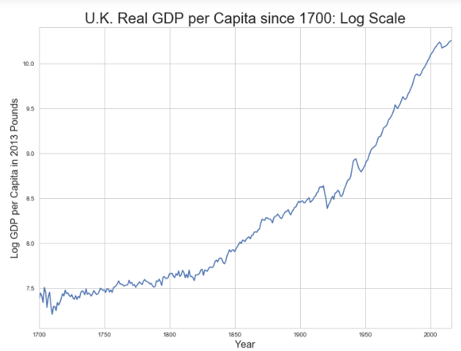
Skipped Topic: Passing the Baton: From Britain to America
The Industrial Revolution took place in Britain
The standard explanation four or five largely independent strands coming together.:
Limited government, security of property, and freedom of contract
Science and the technological tradition of sustained inquiry
Victory in the wars of the Commercial Revolution era
Machinery making, "tinkering", and "gadgets"—primarily made out of metal.
Coal in Britain—the only thing that made a steam engine potentially profitable.
Plus high elasticity of demand for leading-sector products…
http://bradford-delong.com brad.delong@gmail.com

Slide 115
iClickers: Why Breaktrhrough?
The principal reason that the Industrial Revolution took place in late eighteenth century Britain (rather than in Sung China, or Abbasid Baghdad, or Antonine Dynasty Rome, or during the Hellenistic Age) is:
A lack of human numbers thinking about problems of production
A lack of good means of communication—e.g. printing—for diffusing information about how to solve problems of production
A lack of experience using coal as an energy source
A lack of the incentive created by high real wages leading to a strong desire to make labor more productive
None of the above/not enough information
http://bradford-delong.com brad.delong@gmail.com

Slide 116
iClicker: Why Passing the Baton
The principal reason that the twentieth century was an American rather than a second British century was:
The United States’s aggressive and enthusiastic welcome of immigrants
The United States’s focus on broad-based technical education
The United States’s extraordinary abundance of natural resources driving high real wages and enormous incentives to build machines to manipulate matter
A U.S. government that took industrial development as a key policy goal, rather than being comfortable with laissez-faire
None of the above/not enough information
http://bradford-delong.com brad.delong@gmail.com

Slide 117
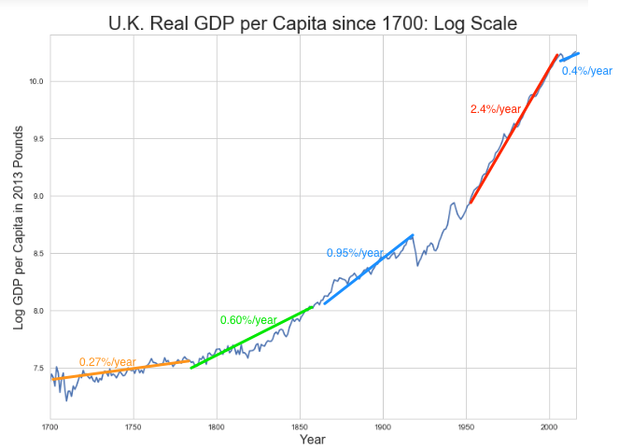
British Productivity Growth Acceleration
http://bradford-delong.com brad.delong@gmail.com

Slide 118
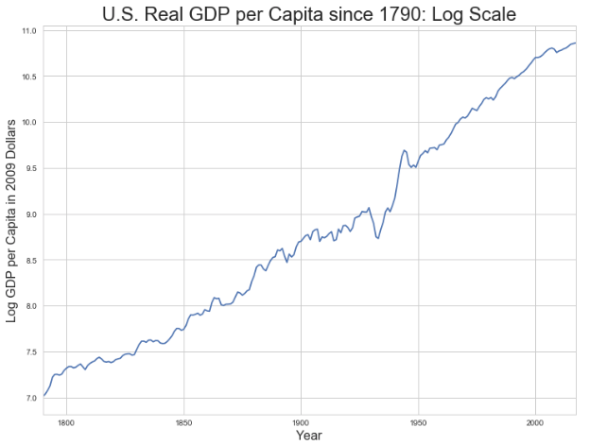
But Even in the First Half of the Nineteenth Century the U.S. Was Outpacing Britain in Growth…
Even in the first half of the nineteenth century—the period in which the British Industrial Revolution made it the wonder of the world—economic growth in the United States was proceeding faster than in Britain.
While British real GDP per capita was increasing at less than 0.6 percent per year
American was growing at a hair over one percent per year.
And a significantly larger share of GDP was going to the white working class in the United States, in the north at least:
The extraordinary abundance of land and the possibility of "lighting out for the territory", in the words of American author Mark Twain, gave even workers without property or notably scarce skills substantial economic bargaining power.
http://bradford-delong.com brad.delong@gmail.com

Slide 119
And Starting in the Late Nineteenth Century
Second Industrial Revolution…
Why the U.S. and Germany, and not Britain?
Immigration and Population
Was resource scarcity no longer a factor?
Was the differential in the growth rate h of the stock of useful economic knowledge even greater than the differential in the growth rate g of the efficiency-of-labor?
http://bradford-delong.com brad.delong@gmail.com

Slide 120
Phases of American Growth
1.0% per year in GDP per capita from 1760-1860: resource abundance
1.6% per year in GDP per capita from 1860-1929:
“Great traverse”: K/Y ratio up from 2.5 to 4
Half of it an increase in savings rates
Half of it a fall in the price of capital goods
2.5% per year in GDP per capita from 1929-1973
“Fordism”
Expected further acceleration: it did not happen
Post-1973
Productivity slowdown 1973-1995 (environment, oil, baby boom, feminism)
“New economy” 1995-2006
Post-2006 collapse of growth
http://bradford-delong.com brad.delong@gmail.com

Slide 121
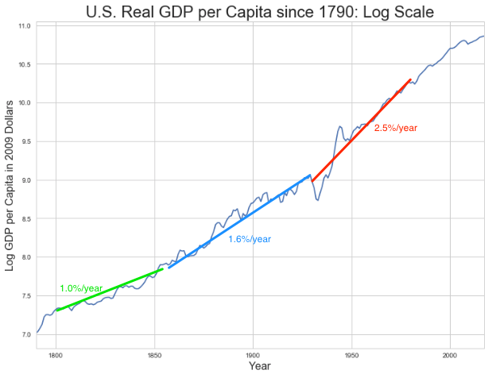
American Productivity Growth Acceleration
http://bradford-delong.com brad.delong@gmail.com

Slide 122
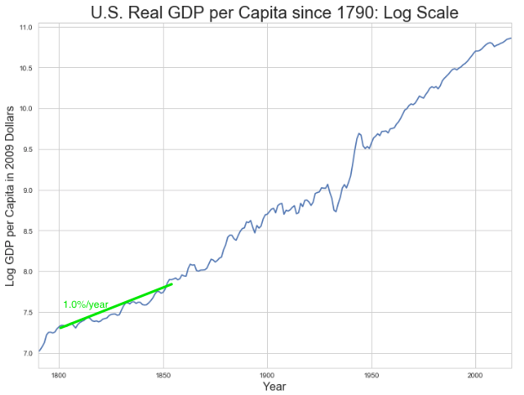
Early Nineteenth Century: Westward Expansion
Westward expansion
The “American System”
Abundant natural resources
Very high real wages
Focus on raising labor productivity
Hence fast efficiency-of-labor growth
Britain, by contrast, focused on economizing on (non-coal) raw materials
http://bradford-delong.com brad.delong@gmail.com

Slide 123
The Importance of Resources 1760-1860
Major westward expansion and "Amerindian removal”
The century 1760 to 1860 before the Civil War.
We have U.S. output-per-worker growth then at about 1.0% per year…
…in contrast to British output-per-worker growth at about 0.5% per year.
We have the U.S. population and labor force growing at 2.5% per year…
…from 2.5 to 30 million.
http://bradford-delong.com brad.delong@gmail.com

Slide 124
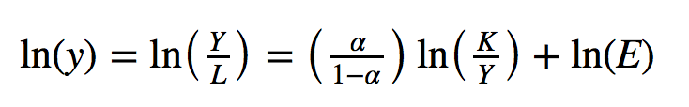
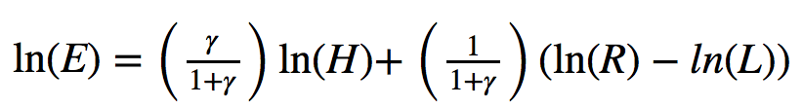
The Importance of Resources 1760-1860
Recall our basic Solow Model:
http://bradford-delong.com brad.delong@gmail.com

Slide 125
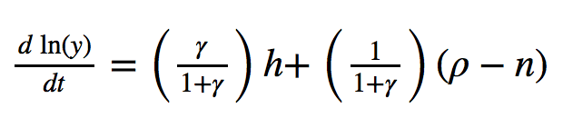
The Importance of Resources 1760-1860
Recall our basic Solow Model:
Assume K/Y constant, so the growth rate g of the efficiency of labor and the growth rate of output-per-worker are the same:
http://bradford-delong.com brad.delong@gmail.com

Slide 126
The Importance of Resources 1760-1860
Recall our basic Solow Model:
Assume K/Y constant, so the growth rate g of the efficiency of labor and the growth rate of output-per-worker are the same:
http://bradford-delong.com brad.delong@gmail.com

Slide 127
The Importance of Resources 1760-1860
Recall our basic Solow Model:
Assume K/Y constant, so the growth rate g of the efficiency of labor and the growth rate of output-per-worker are the same:
Let’s, last, fit this to history in the century before the 1860 election of President Abraham Lincoln and the ensuing American Civil War:
http://bradford-delong.com brad.delong@gmail.com

Slide 128
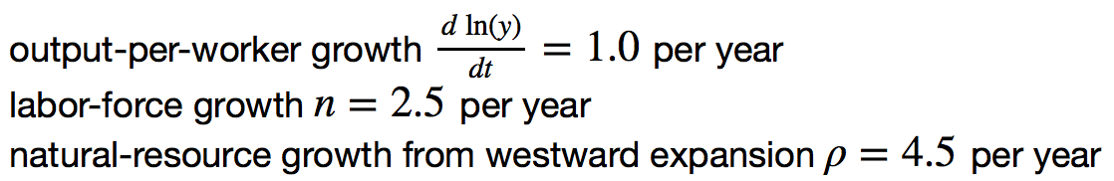
The Importance of Resources 1760-1860
Recall our basic Solow Model:
Assume K/Y constant, so the growth rate g of the efficiency of labor and the growth rate of output-per-worker are the same:
Let’s, last, fit this to history in the century before the 1860 election of President Abraham Lincoln and the ensuing American Civil War:
http://bradford-delong.com brad.delong@gmail.com

Slide 129
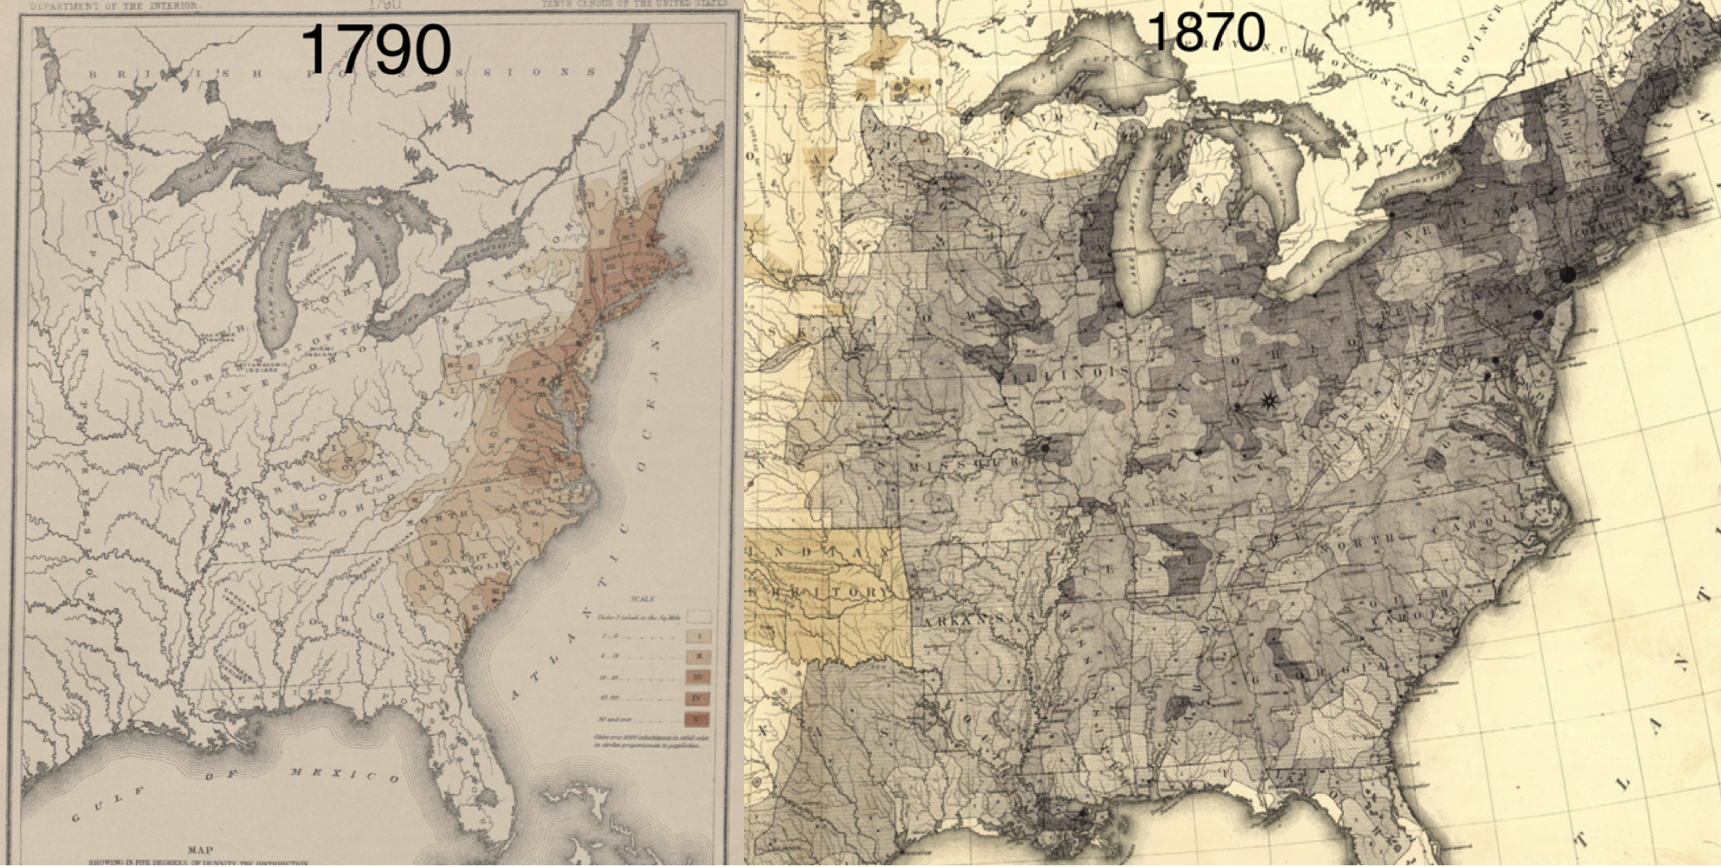
Westward Expansion
http://bradford-delong.com brad.delong@gmail.com

Slide 130
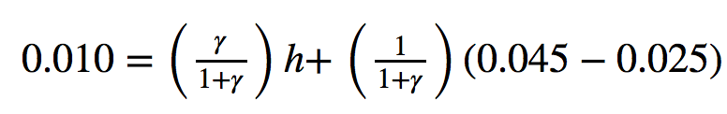
The Importance of Resources 1760-1860
We have two parameters left: γ and h, the weight of ideas in efficiency-of-labor growth and the rate of growth of the stock of useful ideas for the economy in American heads, respectively:
http://bradford-delong.com brad.delong@gmail.com

Slide 131
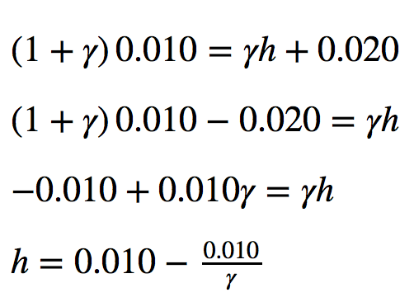
The Importance of Resources 1760-1860
We have two parameters left: γ and h, the weight of ideas in efficiency-of-labor growth and the rate of growth of the stock of useful ideas for the economy in American heads, respectively:
http://bradford-delong.com brad.delong@gmail.com

Slide 132
The Importance of Resources 1760-1860
Thus if γ→∞ then h→0.010
http://bradford-delong.com brad.delong@gmail.com

Slide 133
The Importance of Resources 1760-1860
Thus if γ→∞ then h=0.010
Thus if γ=3.0 then h=0.00667
http://bradford-delong.com brad.delong@gmail.com

Slide 134
The Importance of Resources 1760-1860
Thus if γ→∞ then h=0.010
Thus if γ=3.0 then h=0.00667
Thus if γ=1.0 then h=0.00
http://bradford-delong.com brad.delong@gmail.com

Slide 135
The Importance of Resources 1760-1860
Thus if γ→∞ then h=0.010
Thus if γ=3.0 then h=0.00667
Thus if γ=1.0 then h=0.00
Looking across the Atlantic Ocean to Great Britain, we see that over there it is indeed the case that h=0.005 from 1760 to 1860. Faster growth of h in America due to some catchup with the world's first and leading industrial nation seems likely. So γ=3.0 has some claim to be the most likely value…
http://bradford-delong.com brad.delong@gmail.com

Slide 136
A Counterfactual
The Royal Proclamation of October 1763:
Our Royal Will and Pleasure… no... Governor or Commander in Chief in... our... Colonies or Plantations in America do... grant Warrants of Survey, or pass Patents for any Lands beyond the Heads or Sources of any of the Rivers which fall into the Atlantic Ocean from the West and North West, or upon any Lands whatever, which, not having been ceded to or purchased by Us as aforesaid, are reserved to the said Indians, or any of them...
http://bradford-delong.com brad.delong@gmail.com

Slide 137

What If This Royal Proclamation Had Stuck?
What if ρ=0?
If γ → ∞ and h=0.010 then g=0.01
If γ=3.0 and h=0.00667 then g=−0.00125
If γ=1.5 and h=0.000 then g=−0.01
http://bradford-delong.com brad.delong@gmail.com

Slide 138
What If This Royal Proclamation Had Stuck?
What if ρ=0?
If γ → ∞ and h=0.010 then g=0.01
If γ=3.0 and h=0.00667 then g=−0.00125
If γ=1.5 and h=0.000 then g=−0.01
An America penned behind the Appalachians would probably have seen its living standards and productivity levels not growing at 1% per year from 1760 to 1860 but shrinking.
For γ=3.0, living standards and productivity levels would have shrunk at a pace of -0.125% per year
http://bradford-delong.com brad.delong@gmail.com

Slide 139
What If This Royal Proclamation Had Stuck?
What if ρ=0?
Of course, a poorer America would probably have seen fewer immigrants.
But it might not have seen that many fewer immigrants.
It would no longer have been quite as attractive to move from Britain to America over 1760 to 1860.
But it still would have been very attractive to move from France, Germany, Scotland—or most of all from Potato Blight-ridden Ireland...
In what other ways might this counterfactual alternate-history "little America" would likely have been different in 1860 than America actually was?
http://bradford-delong.com brad.delong@gmail.com

Slide 140

“Trail of Tears’
http://bradford-delong.com brad.delong@gmail.com

Slide 141
A large chunk of America's pre-1860 visible growing prosperity was based not just on African-American slavery, but also on "Amerindian removal"
http://bradford-delong.com brad.delong@gmail.com

Slide 142
Catch Our Breath…
Ask me two questions…
Make two comments…

Slide 143

Late Nineteenth-Early Twentieth Century: “Great Traverse”
Invention of the industrial research lab
First globalization
Technologies of Second Industrial Revolution
Economies of scale and mass production
Falling price of capital goods
Greater savings effort
Plus mass immigration
Rapidly rising inequality
Or was it? Emancipation…
http://bradford-delong.com brad.delong@gmail.com

Slide 144
Capital Deepening
Lowered deprecation rate δ
From 5% to 3% per year
http://bradford-delong.com brad.delong@gmail.com

Slide 145
Capital Deepening
Lowered deprecation rate δ
From 5% to 3% per year
Increased savings rate s
Capital-output ratio goes from 2.5 to 4 across 70 years
http://bradford-delong.com brad.delong@gmail.com

Slide 146
Capital Deepening
Lowered deprecation rate δ
From 5% to 3% per year
Increased savings rate s
Capital-output ratio goes from 2.5 to 4 across 70 years
with an α=1, output-per-worker proportional to the capital-output ratio
ln(4/2.5)/70 = 0.007
g = 0.9%/year
http://bradford-delong.com brad.delong@gmail.com

Slide 147
Capital Deepening
Capital-output ratio goes from 2.5 to 4 across 70 years
with an α=1, output-per-worker proportional to the capital-output ratio
ln(4/2.5)/70 = 0.007
g = 0.9%/year
Second Industrial Revolution
Large managerial corporation
Large-scale investment banking
Industrial research lab
Continent-wide market
Globalization
http://bradford-delong.com brad.delong@gmail.com

Slide 148

Mid Twentieth Century: Drive to High Mass Consumption
DARPA, etc.: two heads are better than one
“Fordist” oligopolies
Second globalization
Keynesian stabilization policies
Falling and then low inequality
For white guys…
http://bradford-delong.com brad.delong@gmail.com

Slide 149
Mid Twentieth Century: Drive to High Mass Consumption
DARPA, etc.: two heads are better than one
“Fordist” oligopolies
Second globalization
Keynesian stabilization policies
Falling and then low inequality
For white guys…
http://bradford-delong.com brad.delong@gmail.com

Slide 150
Catch Our Breath…
Ask me two questions…
Make two comments…

Slide 151
Notes

